Slide 1
Towards Stable and Calibration-Free Motor Imagery BCIs via Graph-Based Transfer Learning
Research Questions/ Gaps/ Motivation | Non-stationarity caused by the progressive neurodegeneration and cortical reorganization will result in the degraded classifier accuracy, and so repeated recalibration should be employed in BCIs. Failing to adapt this temporal and interpersonal variability of EEG signals hinders the real-world development. The limited clinical data and inter/intra-subject variability restrict the effectiveness of existing models. A model that accounts for the full functinal topology of the brain should be constructed because it has been confirmed that MI involves dynamic networks extending beyond the sensorimotor cortex. Additionally, combining transfer learning with graph neural networks presents a promising direction for enhancing model generalizability across sessions and individuals.
Approach to address the gap | Transfer learning has been considered to reduce the calibration time where the domain adaptation can be improved by fine-tuning, a practical method that starts with a pre-trained model on source domain, then updates it on new but related target domains. But this strategy does not overcome the gradual, longitudial shifts of brain signals among clinical populations. On the other hand, Graph Neural Networks have been proved that it can learn subject-general features robust to session drift and inter-subject variability. This paper builds a subject-independent framework in which the model is anchored on a shared, stable connectivity patterns, trained by Graph Attention Network with trial-wise Phase-Locking Value, and evaluated by Leave-One-Subject-Out-Cross-Validation protocal.
Method | Two datasets are selected under the left-right cursor control task to ensure protocol homogeneity. In order to explore the subject-invariant features, graph-based transfer learning is employed in which the Phase-Locking-Value is used to quantify the instantaneous phases of the EEG signals between each electrode pair for each trial. This can result in a n*n square matrix (where n is the No. of channels), and a time series tensor (n*n*t) to capture how the connectivity PLV matrix change over time across multiple trials (i.e. the nonstationarity in graphical form). The invariance of the PLV time series for each eletrode pair can be evulated using the coefficient of variation across trials. And then by averaging the CV values from all subjects, the electrode pairs with the lowest mean CV is identified as the subject-invariant features. The LOSOCV approach is applied to test the model. No calibration data used in out method from the target subject. The resulting graphs are fed into an rPLV-GAT comprising three GATv2Conv layers, followed by global mean pooling and a linear soft-max classifier. The performance of the trained model is compared with seven publicly available approaches.
Results | The graph-based preprocessing reduced raw time-series data from 70 GB to 30 GB of connectivity matrices, which significantly increases the memory efficiency. This lightweight, topologically structured approach avoids the high memory footprint and the restricted hardware compatibility, and so it is more practical in real-time and wearable BCI applications. The resulting connectivity matrices demonstrate some constant hubs shared between participants, suggesting that the PLV matrices are suitable for subject-independent MI classification tasks. The classification accuracy using the GAT-based framework achieves 62.65% on Dataset 1 and 59.21% on Dataset 2, both of which are higher than that by the rest seven baseline models. This indicates the viability of leveraging graph-based EEG representations for the calibration-free MI decoding. The Wilcoxon signed-rank test is employed to perform the statistical comparison. It shows that rPLV-GAT signigicantly outperformed five of the seven baselines in Dataset 1 and three of them in Dataset 2, always with p<5%. This concludes the model’s robustness and statistical reliability across both ALS and healthy populations.
Discussion | The stable functional connectivity patterns extracted by graph-based pipelines across individuals corroborates that MI engages distributed, rather than purely contralateral cortical networks. This further proves the validity of applying the Graph-Attention-Network across the whole cortical areas rather than only focusing on the sensorimotor cortex. There is no significant difference in the classification accuracy between the mindfulness-trained and control participants in Dataset 2, so it reinforces the moderate cognitive variability for this graph-based model, and hence the adaptation for the topological EEG dynamics. The calibration-free decoding paradigm also enhances operational flexibility, benefiting individuals like ALS especially due to the lack of physical and cognitive resources for recalibration sessions. The increased classification accuracy without calibration of the model makes it possible to integrate this model with the context-aware shared control into hybrid BCI systems. Further improvements towards the lightweight online adaptations can be explored using consistency regularization or self-supervised proxy tasks, by which the user’s burden can be minimized and gradual personalization can be achieved.
Limitations/ Assumptions | I. Low-performing individuals with 50-55% classification accuracy benefit less. This can be addressed by employing the Maximum Mean Discrepancy and integrating in graph-based frameworks to treat different users more equally. II. Larger datasets demand more powerful models. While the graph-based model can handle moderate-scale graphs effectively, it is worthy exploring how to scale GNN depth and expressivity, so that it can deal with richer temporal structure and higher node counts. III. The subject-general graph structure among other paradigms beyond the cursor-control MI tasks used in this paper should be furthered investigated.
Conclusion | The longitudinal nonstationarity is addressed by introducing a subject-independent framework that leverages stable connectivity patterns captured from PLV graphs and GAT-based models. The results supports the viability of topological EEG representations for user-friendly BCI systems with no need for calibration. Furture works can focus on the extension of this pipeline to other paradigms and boosting the classfication accuracy for low-performing users, thereby enhancing the clinical utility of calibration-free BCIs.

Slide 2
Auto-Adaptive Model for Longitudinal Motor Imagery Decoding in Amyotrophic Lateral Sclerosis
Research Questions/ Gaps/ Motivation | Because the ALS is a progressive neuromuscular disease, the motor neurons will gradually degenerate as the disease progesses, resulting in the cortical reconfiguration. The EEG non-stationarity is the key obstacle limiting BCIs development in clinical settings for ALS patients, because the covariate change in training and testing data will lead to a large reduction of prediction accuracy over time. Therefore, the models need to be retrained upon every sessions, but the training and recalibration of these devices spent crucial time, making it impossible in uninterrupted, practical usage.
Approach to address the gap | Regularization of parameter estimation has been wisely acknowledged to be essential in BCI research, so adaptive techniques for feature space adaptation become crucial especially when training and testing data diverge. Faller et al. had employed autocalibration and adaptation for ALS, whose reserach emphasized the need for improved performance; In another study with six SCI patients, a 69.5% accuracy rate was achieved using a feedback loop for mutual learning, while the accuracy rate reduced slightly when more SCI patients joined in a coadaptive system. These prior studies indicate the lack of coadaptive algorithms in ALS patients. Establishing feasibility of the coadaptive BCI in ALS patient data can contribute to the reduced expert intervention and simpler training in real world, longitudinal setting.
Method | The Filter bank Common Spatial Pattern (FBCSP) algorithm separates the EEG signal into multiple bands. The Common Spatial Pattern extracts five optimal feature columns that maximize the separation between two classes (one vs. rest), wihch are then used to train three classifiers. The projection matrix W converts raw EEG data X into the new feature space Z, i.e. W * X -> Z. In order to adapt the non-stationarity, either the W or the classifier should be kept updating, using either the cumulative data retention method or the windowing. The overfitting caused by the increasing data complexity in the cumulative data retention method can be mitigated by the windowing method. It maintains a constand data size E, and once the window is emptied, the W is retrained. A linear discriminant analysis (LDA) is used as the classifier for the windowing to separate the feature space.
Results | The grid optimization process is employed to optimize the data size (E) and the window length (WL) parameters in the proposed model, ranging from 21 to 30. Without updating the W or the classifier, the BCI performance decreases over time for the newer testing data. However, our adaptive model achieves classification accuracy > 70% with constant performance, except two subjects, but still within reasonable bounds (4 - 9%). Eight ALS patients yield 72.6% accuracy on average, using the windowed data retention strategy. The maximum mutual information suggests the top ten features can provide best classification. To simplify setup and reduce computational complexity, PCA is applied to select the top-informative electrodes to train classifiers in the adaptive model. The consistent 80% accuracy can be maintained for Subject 9 using only six electrodes among the total 22 ones.
Discussion | Although electrode optimization does not consistently enhance optimal accuracies, and reducing electrodes may slightly decrease the overall accuracy, but it is still worth identifying optimal channels, because it can improve the accuracy for lagging classes for most users and reduce complexity and setup requirements with minimal overall accuracy compormise. The electrode optimization further confirms that specific/different cortical areas are activated during different MI classes. Compared to the state-of-the-art, our study is targeted for ALS patients, which is the only end-user group with progressive non-stationarity, leading to more robust and versatile models built in this paper. Using the popular FBCSP techniques, we provide a framework for online multi-class coadaptation and introduce the windowing data retention method to update Spatial Filter and Classifier. So it improves performance and robustness over time, making it possible for longitudinal clinical usage with ALS patients. The severity of ALS does not correlate with the classification accuracy, while the cognitive condition and age do affect SMR control and hence the BCI performance.
Limitations/ Assumptions | I. Online testing should be validated with ALS patients in real time. II. This paper assumes that correct and incorrect trials can be identified, but could not always hold in reality. The Error Related Potentials and IMU’s can be the potential modalities to address it. III. To drive more effective adaptation over time, tracking Mutual Information between feature vector and correct label as an adaptation metric could be explored.
Conclusion | The proposed coadaptive model apply the automatic parameter tuning to achieve the high performance in longitudinal use without expert recalibration, enhancing the clinical applicaiton of the BCIs for ALS patientis. Two dimensions of redundancy in this model: (1) remove less irrelevant frequency bands; (2) reduce the number of electrodes. Three further work directions: (1) hardware implementation; (2) investigate the declining ALSFRS scores -> further enhance longitudinal robustness; (3) find some supplementary data enhancing methods -> achieve higher BCI performance.

Slide 3
Advancing EEG classification for neurodegenerative conditions using BCI: a graph attention approach with phase synchrony
Research Questions/ Gaps/ Motivation | motor impairment -> gradual degeneration of motor neurons -> difficulty in functional control of muscles -> change in ALS patients’ brain -> cortical regeneration -> weaker event-related desynchronization -> EEG non-stationarity -> BCI illiteracy (not meet the required 70% c.a.) -> lack of longitudinal experiments By utilizing connectivity measures to identify unique spatio-temporal patterns, covariate shifts (inter-session) and user-specific variations (inter-subject) can be addressed, so reduce the need for frequently model retraining, hence enhancing long-term BCI performance by means of personalization. Previous findings suggest that the phase synchrony is a reliable feature for subject-specific models. PLVs of EEG signals can be represented as a network-level graph to build a graph convolutional networks. GATs designed for spatial feature extractions do NOT fully leverage connectivity measures e.g. PLV, which can demonstrate impressive accuracy.
Approach to address the gap | To fine a solution to overcome the intersubject and intersession variability, this paper leverages spatially-distributed phase synchrony patterns (PLVs) to capture dynamic relationships in MI EEG data for ALS patients, along with the application of graph classification with an attention mechanism (3-layers GATs) to classify MI over multiple session.
Method | i. PLV calculation: Hilbert transform H(s(t)) -> obtain the instantaneous phase φ(t) in radians of a signal s(t); calculate the phase difference between two channels; get the PLV for each trial in a graph, representing the synchronicity between each pair of nodes. ii. graph generation: for each graph, a node feature n*f matrix X can be obtained from band power of signals, from 8 to 40 Hz in 4 Hz increments, and an adjacent matrix A can be extracted from PLV (above threshold ones are identified as connections); Frobenius Norm -> global differences between two adjacent matrices Graph Distance -> local node-to-node differences iii. GAT architecture: using PyTorch Geometric, the GAT model includes three GAT convolutional layers with ReLU activations and Graph Batch Normalization; Global Mean Pool collapses node feature into one graph-level feature vector in the final layer, which is then passed through a sigmoid function to generate class probabilities; Adam optimizer is employed to update weights by minimizing the cross-entropy loss; a 10-fold cross-validation approach ensures each fold of dataset is used both for training and testing, so it is used to evaluate the generalizability of the model. epoch of 250 & learning rate of 0.001 -> optimize convergence and prevent overfitting
Results | (1) Computing covariance, Pearsons Correlation Coefficient and PLV matrices, it is found that PLV consistently yielded the lowest GD and FN values compared to Covariance and PCC across ALS subjects. -> PLV should be selected as the primary measure of connectivity, due to its stability performance across time and subjects. So it can capture more consistent brain connectivity patterns over time. (2) Compared with several state-of-the-art models across the two datasets, GAT shows the improved c.a. (most exceed 70% threshold), with gains of 4.06% for ALS and 1.89% for healthy participants. -> the necessity of the attention mechanism in enhancing c.a. (3) For individual subject, GAT+PS model achieves results comparable to established methods e.g. CSP and CSSP. -> GATS still need further refinement
Discussion | I. The c.a. for ALS patients (74.06%) improves with GAT+PS (phase synchronization) compared to other deep learning models; -> GAT+PS captures more stable network connections over time; -> BCIs using graph-based connectivity representations could be particularly effective for people with neurodegenerative diseases and patients with ALS with cognitive impairments. II. Using pairwise f-tests to analyse variance -> GAT+PS effectively reduces variance for healthy subjects, while a more limited reduction in ALS subjects -> GAT+PS can mitigate inter-subject variability in several instances. III. While the model consistently achieves high accuracies, the specific attention to node pairings during training rarely aligns with the learned patterns during testing. -> Although attention heads isolate subject-specific features during training, the model tunes effectively by focusing on different neural patterns across subjects during testing. IV. GAT’s performance benefits from a balanced representaion of graph features across layers. The optimal No. of attention heads is also dataset-specific and subject-specific.
Limitations/ Assumptions | I. GAT+PS pipeline should only be validated with matched controls and under certain neurological conditions. II. Comparisons between healthy and ALS datasets are limited by differences in data collection methods. -> The consistently high performance across both datasets should be further validated using additional publicity available datasets.
n: No. of channels, f: No. of features
guarantee granularity but prevent overfitting
spectral features (ERD/EDS)
spatial features (PLVs)
quantify the dissimilarity between graphs,
assessing the feature stability
GAT+PS effectively captures subject-specific trends and achieves low variance

Slide 4
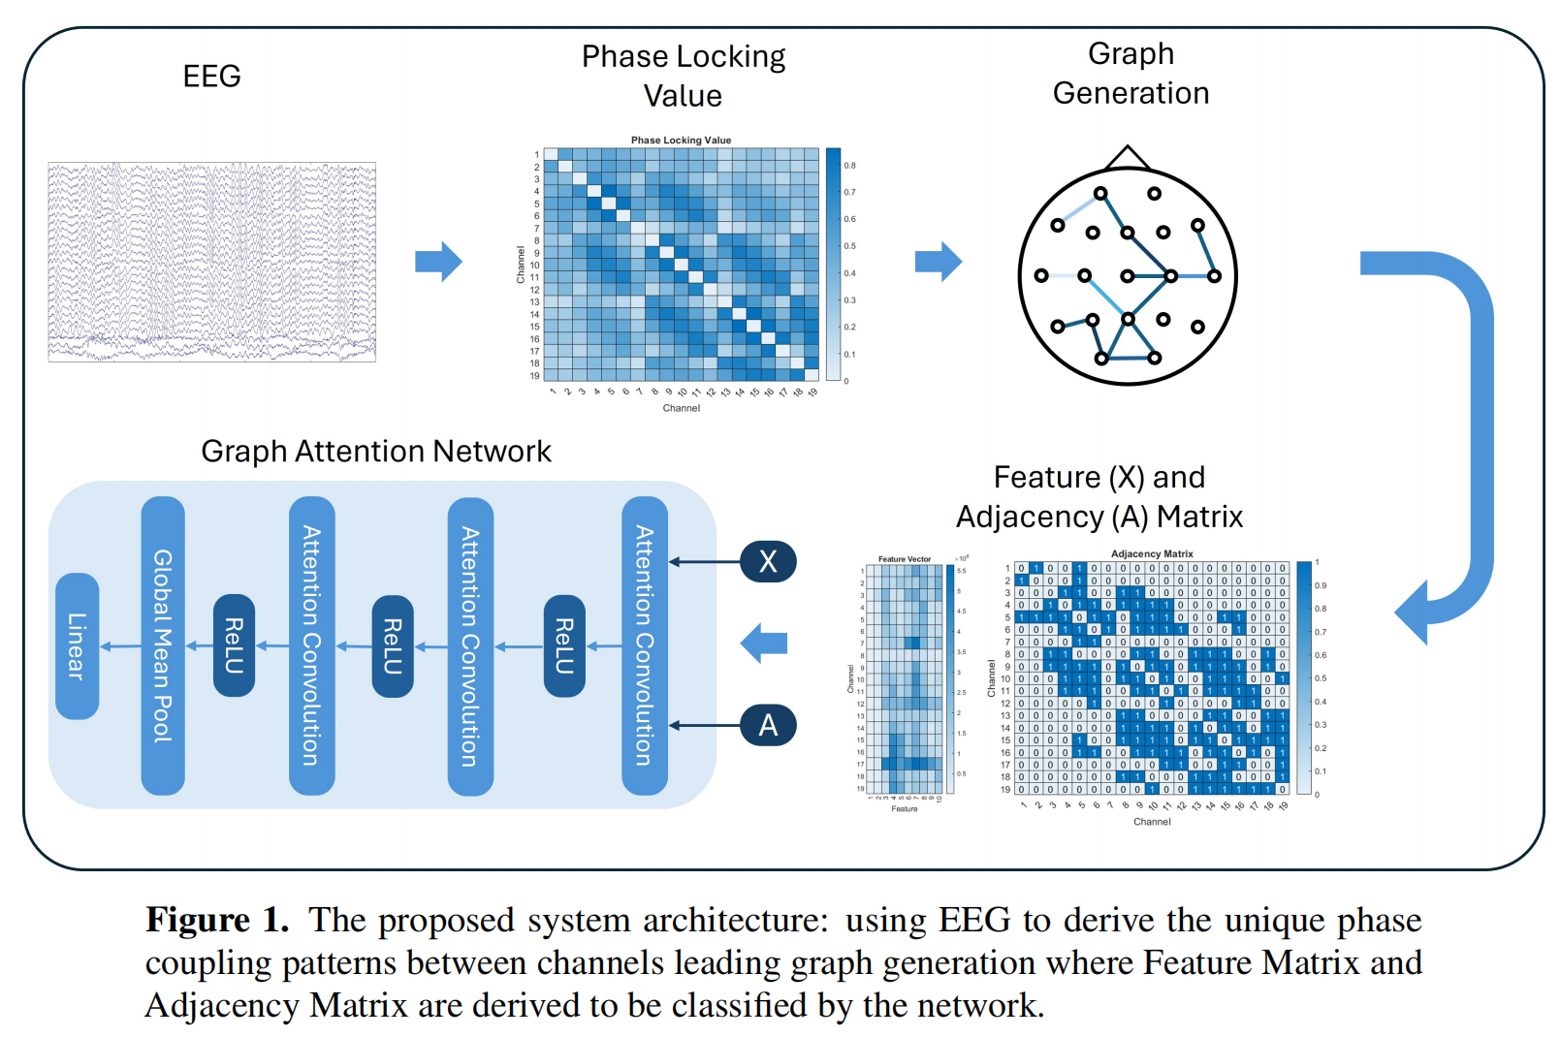
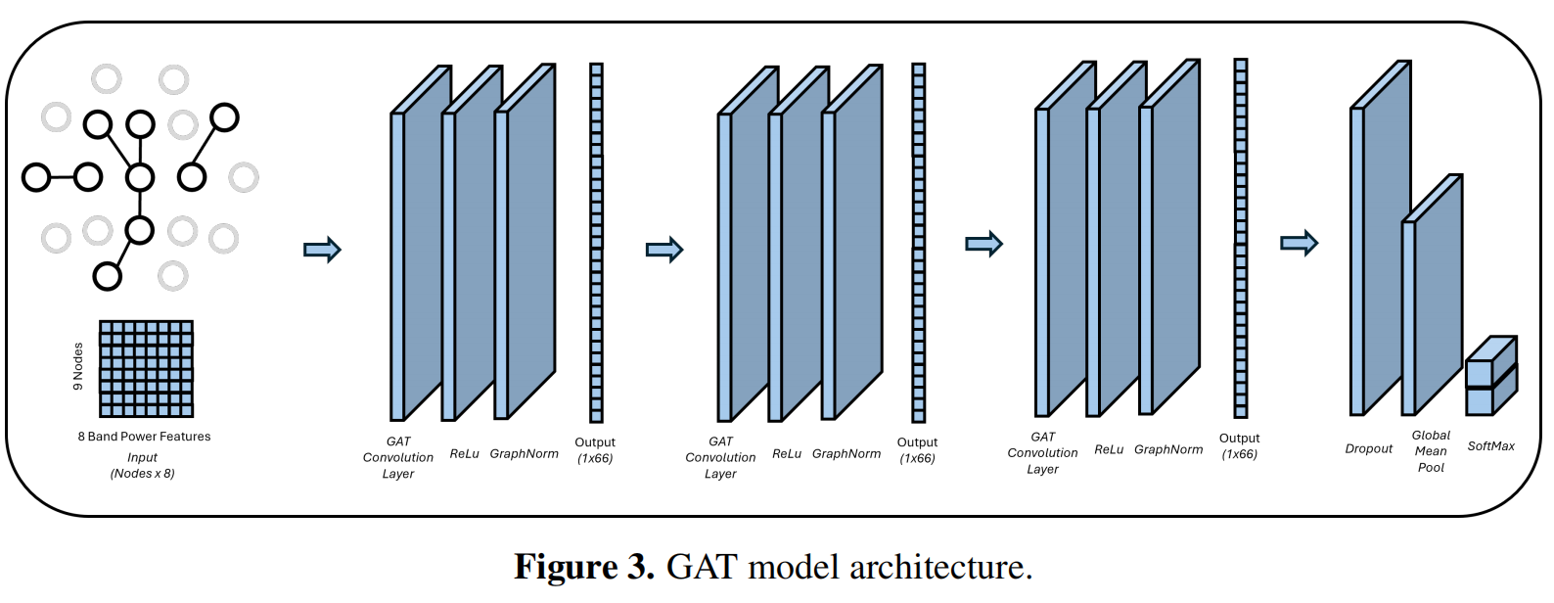
Advancing EEG classification for neurodegenerative conditions using BCI: a graph attention approach with phase synchrony
Conclusion | (1) A simplified graph attention network model is proposed, using phase-locking values for graph structure and band power as feature vectors; -> high subject-specific performance with low variance, enhancing BCI accessibility across diverse user groups. (2) The PLV-GAT model achieves higher c.a. for both healthy and ALS participants; (3) The model maintains low variability across different subjects, even in longitudinal datasets; -> promise for robust & adaptive BCIs. Future work suggestions: I. inter-session generalization of GAT+PS should be investigated by performing cross-session evaluations and online studies; investigate the minimum amount of training data required for stable inter-session decoding; -> enhance the longitudinal feasibility of GAT and graph-based processing. II. incorporating spatial filtering may further optimize the GAT architecture; incorporating a broader range of feature representations, e.g. cross-frequency coupling, may improve the model. III. edge application could be a potential area for GAT+PS to innovate. IV. optimize No. of features and No. of attention heads -> maintain high performance, without introducing unnecessary complexity and reducing accuracies.

Slide 5
Enhancing Cross-session Motor Imagery Classification using Graphical Models in ALS Patients
Research Questions/ Gaps/ Motivation | Due to the non-stationarity, EEG patterns would change as ALS progresses. Traditionally, the model-based approaches do not provide adaptive methodologies to accommodate these changes, because they limit the feature space by only looking for contraleteral separation around the central motor regions. But the graph theoretical methods, by representing EEG signals as graphs, capture larger distribution of stationarity-invariant features in a single training set, which can therefore allow the model to adapt effectively to the complex nature of EEG signals in non-stationary longitudinal scenarios. Current adaptive BCI researches lack the robustness on the longitudinal spacing and sufficient channels. Previous works have compared spectral, amplitude, and phase coupling methods, but did not yet consider similarity matrices which can resist non-stationarity in MI.
Approach to address the gap | To ensure the cross-session generalization of the adaptive method, our work employs longitudinal datasets with multiple sessions spaced across meaningful time intervals, collected from ALS patients and SHU healthy participants. The impact of connectivity/similarity matrices should be evaluated in their effectiveness over non-stationarity periods. The graphical methods incorporated with graph attention networks (prioritize significant spatial and temporal features) should be assessed if they can learn more robust feature representations in a single training set to improve the classcification accuracy.
Method | For the non-stationary EEG data, the distribution of the training set P(X_{train}, Y_{train}) and that of the test set P(X_{test}, Y_{test}) become increasingly dissimilar as time progresses. Deep learning offers a solution to this by performing iterative optimization over the input features X. During training, networks (e.g. f_{GAT}) must adapt their weights θ over epochs t to minimize the loss function L between the model’s prediction and the true labels. However, P(X_{test}) will shift over time due to non-stationarity, graphical methodologies, e.g. CFC, MSC, PLV and CMI graphs capturing connectivity structures between signals, are employed to update θ* in order to match the new distribution. These graphical representations are fed into the GAT model to build an n*n feature vector. Node features are aggregated via three masked self-attention mechanisms and averaged into a graph-level feature vector for classification. Testing is performed on unseen sessions to assess generalization. Interpretability is enhanced using GNNExplainer and electrode-wise ablation analysis, enabling identification of key brain regions invariant to session variability, so that the cross-session generalization can be justified.
Results | PLV consistently yields 15-30% lower Frobenius norm values compared to MSC, CFC and CMI, suggesting that PLV captures more stable and reliable connectivity patterns across both the SHU and ALS datasets. Three graph layouts offer unique perspective on the underlying connectivity and feature interactions, deepening our understanding of how the GAT captures task-relevant information. Kamada-Kawai: highly connected nodes; spectral: global connectivity patterns; circular: relatice connection comparisons. The ablation study removes specific groups of brain regions and observes changes in BCI performance, suggesting that the inherent redundancy in the EEG data allows the model to more effectively identify subject-specific neural signatures across sessions. Four tests are used to statistifcally validate the model differences. ANOVA: to assess if means of different models are identical under normality; Friedman: for robust non-parametric non-normality testing; Levene’s test: to assess variance equality; mixed effects model: to compare against a baseline (CSP+SVM). Results suggest that several graphical methods significantly outperform the CSP+SVM baseline, while the mean accuracy and performance variability differ across models and sessions.
Discussion | Conventional approaches fail to provide sufficient control accuracy with non-stationarity, while the method in this paper proves the feasibility of an optimized set (θ) that improves BCI performance for each test distribution independently. This is because this data-driven method can extract a broader and more diverse feature set, capturing subject-specific communication pathways, and hence enhancing robustness and adaptability in BCI applications. Although the connectivity networks evolve patterns over sessions, there is a gradual refinement of motor-related synchrony in the natural Frontal, Central and Parietal hubs, making it possible for graphs to capture task-related pattern over time. PLV has the lowest Frobenius Norm scores (superior stability, improved accuracies, and low computational cost), indicating it the most reliable feature against cross-session variability. But CMI shows high stability across datasets, suggesting that higher order features are resilient to fluctuations. A few main hubs (e.g. central sensorimotor regions) generalize across participants, suggesting that subject-independent models can enhance BCI performance by reducing the calibration burden and better capturing the neural dynamics underlying MI. The network architecture may be more critical to performance than the specific graphical features used, indicating that the classification model extracts task_x0002_relevant information embedded across diverse inputs. Our GAT-based model performs well in the ALS model space while maintaining a lightweight architectur marginally slower than biological motor signal transmission. Ablating certain brain regions to test the redundancy caused by network visualization shows that removing redundant electrodes can significantly improve accuracy. Model performance varies in both average accuracy and session-to-session consistency, highlighting the importance of selecting both appropriate model architectures and contextual sessions to achieve robust and generalizable BCI performance.
Limitations/ Assumptions | Although the model performs well overall, identifying exactly which epoch contains the most optimal training weights for each future test session remains difficult. This hinders real-time optimization since the performance can vary depending on the selected epoch. This could be addressed by meta-learning, where the model is trained across tasks such that when it encounters new tasks, only a few gradient steps are needed to achieve near-optimal performance. This allows the model to quickly fine-tune for future unknown distributions with just a few shots, through minimal adaptation and data acquisition. It is also necessary to accommodate the inherent variability of patient sessions.
Conclusion | Future work suggestions: (1) combine longitudinal EEG with ALSFRS/learning tracking to study the correlations between EEG-based changes and clinical decline or learning effects; (2) explore approximate methods that preserve the informative properties while enhancing computational efficiency and online feasibility; (3) identify most informative band-pair couplings in CFC; (4) improve general models to reduce session/subject-specific non-stationarity; (5) experiment with hidden node configuration beyond uniform allocation; (6) optimize inference delay for real-time BCI responsiveness. This paper improves the extraction of meaningful information from a single training set and demonstrates practical models for constructing graphical pipelines to address cross-session non-stationarity in ALS.

Slide 6
Enhancing Cross-session Motor Imagery Classification using Graphical Models in ALS Patients
1. Problem:
⟶ Cross-session EEG variability limits BCI generalization.
2. Input features:
⟶ Construct connectivity matrices using PLV, MSC, CFC, and CMI.
3. Model:
⟶ Feed graphs into Graph Attention Network (GAT).
4. Training:
⟶ Optimize weights θ over epochs t to minimize loss.
5. Key advantage:
⟶ GAT learns stable (stationarity-invariant) synchrony patterns.
6. Outcome:
⟶ Improved cross-session classification accuracy & consistency.
in this paper, only one training set is employed, no validation set to evaluate which epoch performs the best across sessions
limitation: which training iteration gives the best model weights for generalization?
consistent c.a. and computational efficiency
for future data
epoch: one full pass through the training dataset during model optimization
e.g. if the training dataset includes EEG data from 6 sessions, one epoch means the model sees all of those once

Slide 7
Temporal Graph Networks for Deep Learning on Dynamic Graphs
continuous-time dynamic graph:
time-stamped events
TGN as encoder
the embedding of graph nodes z(t)=(z₁(t), ..., z_{n(t)}(t)) for each time t
decode
task-specific prediction
e.g. node classification
Research Questions/ Gaps/ Motivation | Current deep learning methods predominantly operate on static graphs, while most real-life interations and relations of systems are dynamic. It is sub-optimal to apply static graph deep learning modelsto dynamic graphs by ignoring the temporal evolution. Recent learning on dynamic graphs are limited to the setting of discrete-time dynamic graphs represented as a sequence of snapshots of the graph, which can overlook the interactions between snapshots and artificial time boundaries may introduce discontinuity. Therefore, they are unsuitable for real world settings where dynamic graphs are continuous and evolving, necessitating the development of approaches that can effectively capture the fine-grained temporal dynamics of evolving graphs in a continuous-time framework.
Approach to address the gap | I. propose the generic inductive framework of Temporal Graph Networks operating on continuous-time dynamic graphs represented as a sequence of events; II. propose a novel training strategy -> the model can learn from the sequentiality of the data while maintain highly efficient parallel processing; III. perform an ablation study of different components in our TGNs framework -> analyze the tradeoff between speed and accuracy; IV. show state-of-the-art performance on multiple tasks in both transductive and inductive settings -> TGNs are much faster than previous methods.
Method | TGN memory modules: embedding: vector representation z_{i}(t) of a node i at time t. -> avoid memory staleness problem (the node embedding becomes out-of-date) by aggregating information from a node’s neighbors memory; -> keep node representation always relevant and up-to-date.
Results | TNG training: The memory-related modules updates memory as long as an event happens, so they do not receive the immediate feedback from the loss. At any time t, the Raw Message Store contains (at most) one raw message rm_{i} for each node i, generated from the last interaction involving i before time t. When the model processes the next interactions involving i, its memory is updated using rm_{i}, then the updated memory is used to compute the node’s embedding, the interaction prediction and hence the batch loss. Finally, the raw messages for the new interaction are stored in the raw message store. Limitation of batch training: All predictions in the same batch have the same state of the memory (i.e. the initial zero memory), which means that the memory is up-to-date for the first interaction while the same memory is out-of-date for the last interaction. So a too big batch size would result in the late memory update, reducing the prediction accuracy. As a result, a batch size of 200 to be a good trade-off between speed and update granularity.
Discussion | In the future edge prediction, our model outperforms the baselines by a large margin in both transductive and inductive settings on all datasets; in the dynamic node classification, out model demonstrates a large improvement over all other methods. Our model TGN-attn is up to 30× faster than TGAT per epoch due to the efficient parallel processing and only one graph attention layer, while requiring a similar number of epochs to converge. Ablation study: (1) memory: the models with memory consistently outperform the models without memory, confirming the importance of memory for learning on dynamic graphs; (2) embedding module: the ability to obtain more recent information through the graph, and to select which neighbors are the most important are critical factors for the performance of the model; (3) In TGN, only one layer of graph attention is enough to obtain very high performance due to the presence of the memory, which can speed up the model dramatically.
Limitations/ Assumptions
Conclusion | We introduce the temporal graph networks for deep learning on continuous-time dynamic graphs, obtaining state-of-the-art results and higher speed than previous methods. The ablation studies suggest the importance of: i. memory -> to store long-term information about a node; ii. graph-based embedding medule -> to generate up-to-the-date node embeddings. Future works remain the exploration of more advanced settings of TGN model and more appropriate domain-specific choices.
used to update node i’s memory
(for multiple events involving the same node i in the same batch)
new event e_{ij}(t) or v_{i}(t)
learnable message function msg
output
m_{i}(t)
...
...
aggregation
function agg
output
past memory s_{i}(t⁻)
m_{i}(t)
memory updator mem
output
new memory s_{i}(t)
s_{i}(t-)
(using messages from previous batches to avoid information leakage)
update memory
then
predict the batch interaction

Slide 8
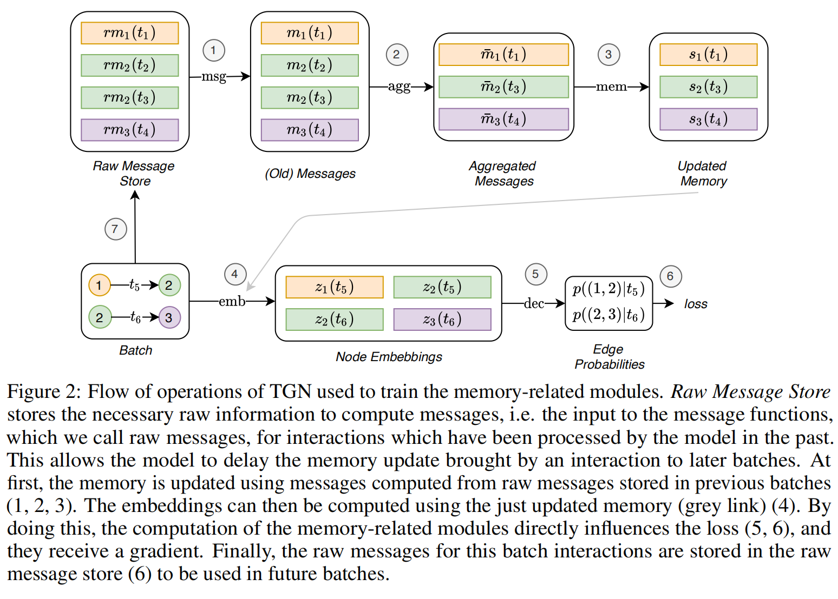
Temporal Graph Networks for Deep Learning on Dynamic Graphs
update memory
(using messages from previous batches)
batch size = 200
compute node’s embedding and batch loss
(predict the batch interactions)
new interaction
(all predictions in the given batch have access to the same state of memory)

Slide 9
This project aims to apply the temporal graph networks as an encoder to improve the MI classification accuracy in ALS.
 | Graph Attention Networks | Temporal Graph Networks
Memory | none | memory modules keep updating sᵢ(t) at every event
Input | trial-wise time-averaged PLV graphs (discrete) -> overlook dynamic structures | event-driven node interaction streams (continuous) -> capture real-time temporal evolution
Computational Load | higher, requires multiple training iterations to find optimal weights θ | lower, only one layer needed due to the presence of the memory
 | Offline | Online
... | ... | ...
TGNs can capture long-term dependencies for each node in a graph.
When a new node is introduced, its memory is initialized as a zero vector and updated after every event involving the node—even after the model is fully trained.
If this hypothesis holds, we should observe improving classification accuracies over time as the model adapts to signal changes.

Slide 10
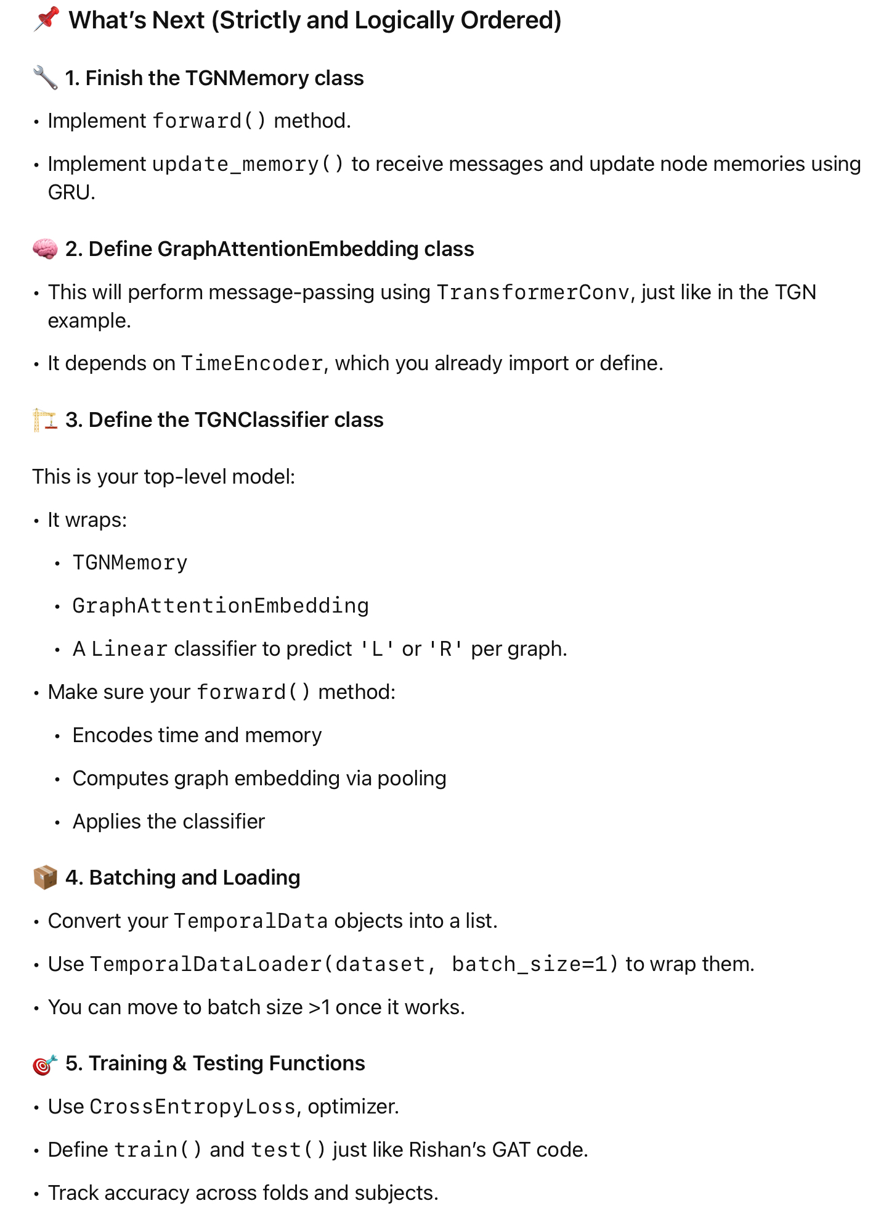
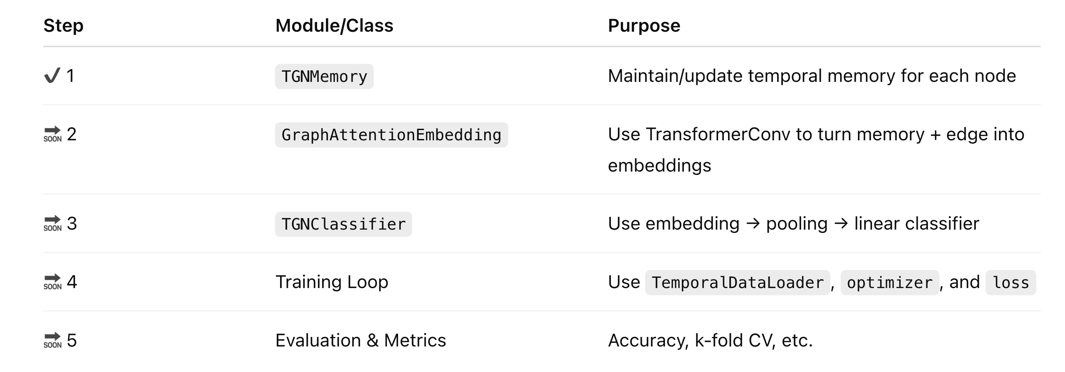
TGN Model Overview
把模型的定义和初始化放在交叉验证的循环里，意味着每一折（fold）都会重新初始化一个全新的模型，这样可以确保每一折的训练和测试都是在相同的起点上进行的，避免模型在不同折之间产生“记忆”或者偏差。这样做可以让交叉验证的结果更加可靠和公正。

Slide 11
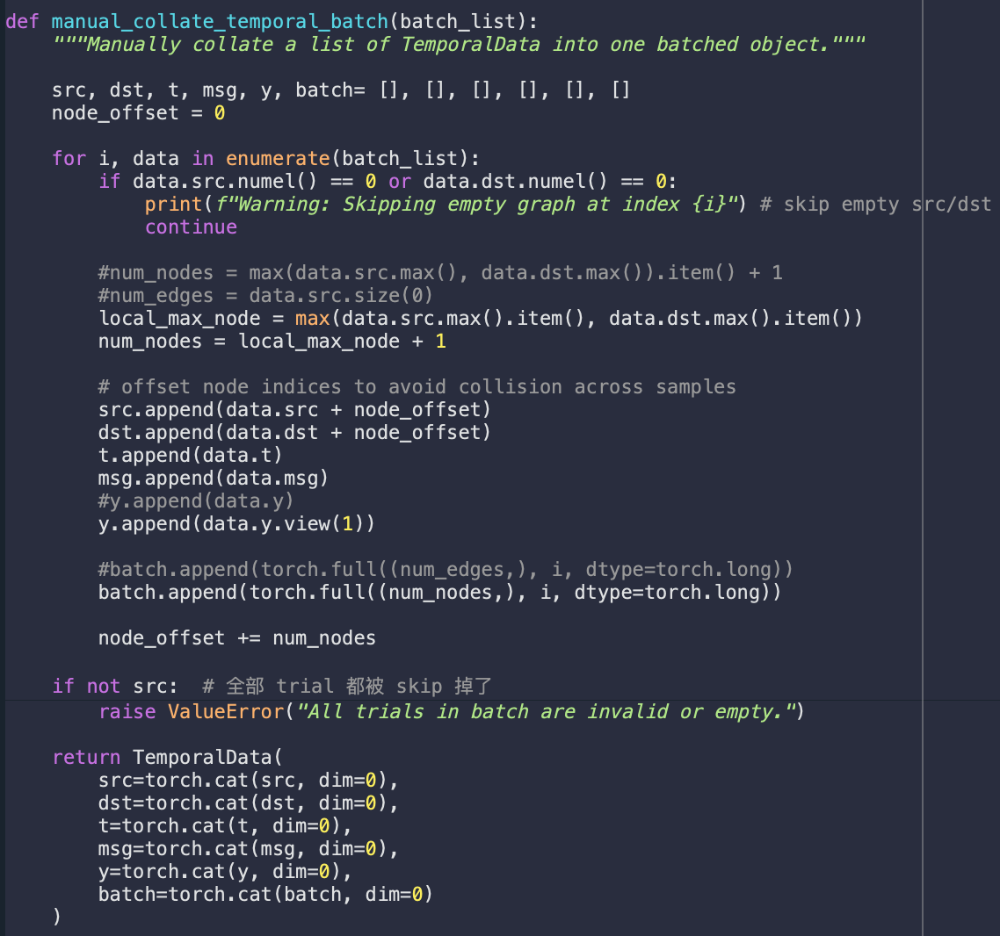
TGN Model Overview
device = torch.device('cuda' if torch.cuda.is_available() else 'cpu')
-> Check whether this computer has a CUDA-enabled GPU, then PyTorch will run tensors and models on GPU (much faster for deep learning tasks), otherwise it will run on CPU (standard processor).
‘manual_collate_temporal_batch’ function
-> TemporalDataLoader causes attribute errors; but
-> In orde to train a deep model efficiently, we do batch processing manually (combine multiple trials into one batched TemporalData object), i.e. process interactions in mini-batches of events, which improves computational efficiency and enables training with stochastic gradient descent (Rossi et al., 2020).
interaction: one window of EEG data; event: one PLV edge in a trial; mini-batch: multiple PLV graphs at once.
Notes:
‘manual_collate_temporal_batch’function: manually group several trials into one TemporalData object.
batch_size = 32 指的是一次喂入 TGN 模型的 32 个 EEG 时间窗（windows），每个 window 是一个 TemporalData。
improves computational efficiency: the memory module can now learn over several graph streams at once.

Slide 12
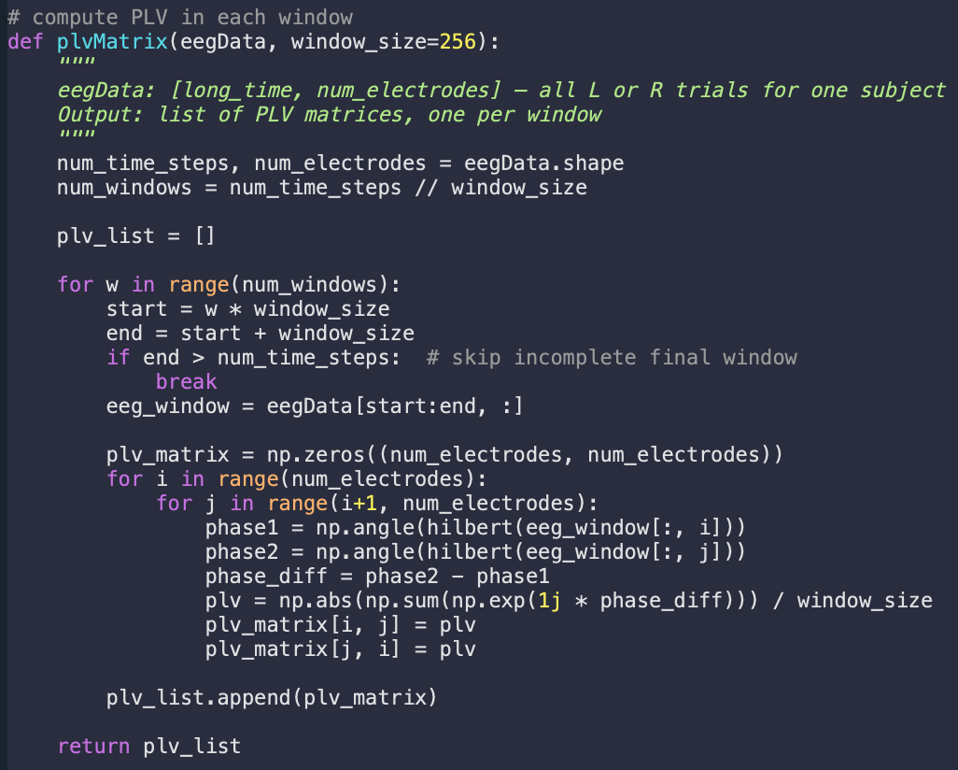
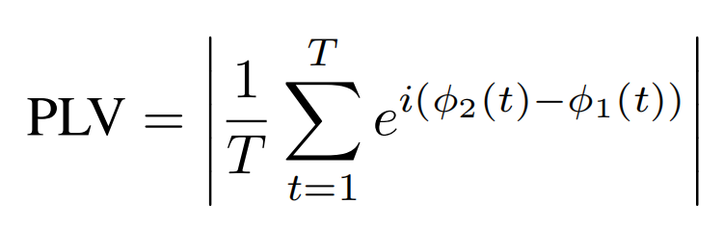
TGN Model Overview
‘plvMatrix’ function
-> Input: EEG data for one trial, with shape [timesteps, electrodes];
-> Slice this EEG trial into sliding windows with window size = 256, the same as sampling rate 256 Hz, so each window = one second;
-> Compute a PLV matrix (Phase Locking Value, connectivity strength/synchrony between each pair of electrodes) for each window using equation, storing them in a list.
-> These quantities will serve as time-evolving edge weights to build up TGN model later on...
where T is the number of timesteps within each window,
φ₁(t) and φ₂(t) are instantaneous phases of signals of two electrodes.

Slide 13
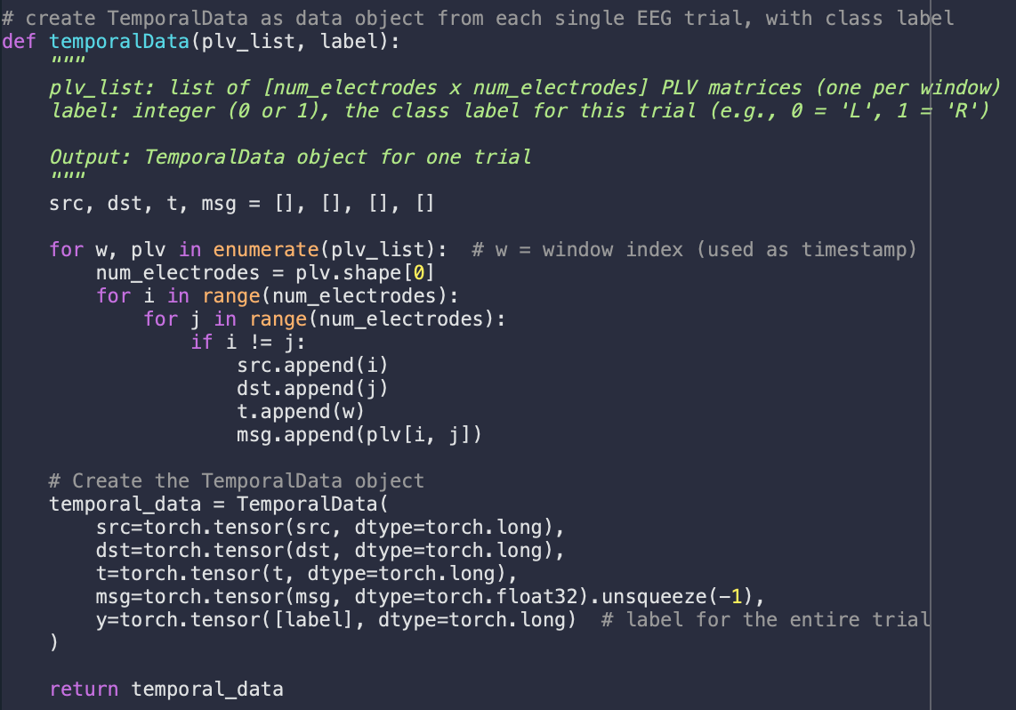
TGN Model Overview
‘temporalData’ function
-> Convert a list of PLV matrices with labels (0 for ‘L’ or 1 for ‘R’) into a PyTorch Geometric TemporalData object, used as input for TGN;
-> This TemporalData object, composed by a stream of events with structured messages, is designed to describe a continuous-time dynamic (temporal) graph;
-> To represent an event, four attributes are required:
1. src: a list/tensor of source node indices for each event;
2. dst: a list/tensor of destination node indices for each event;
3. t: a tensor specifying the time at which each event occurs (i.e the timestamp when each edge happens);
4. msg: a tensor of messages passed along each edge. In this EEG-PLV model, use the PLV values between electrodes i and j as edge weights/features;
5. (additional) y: class ‘L’ or ‘R’ for each event.

Slide 14
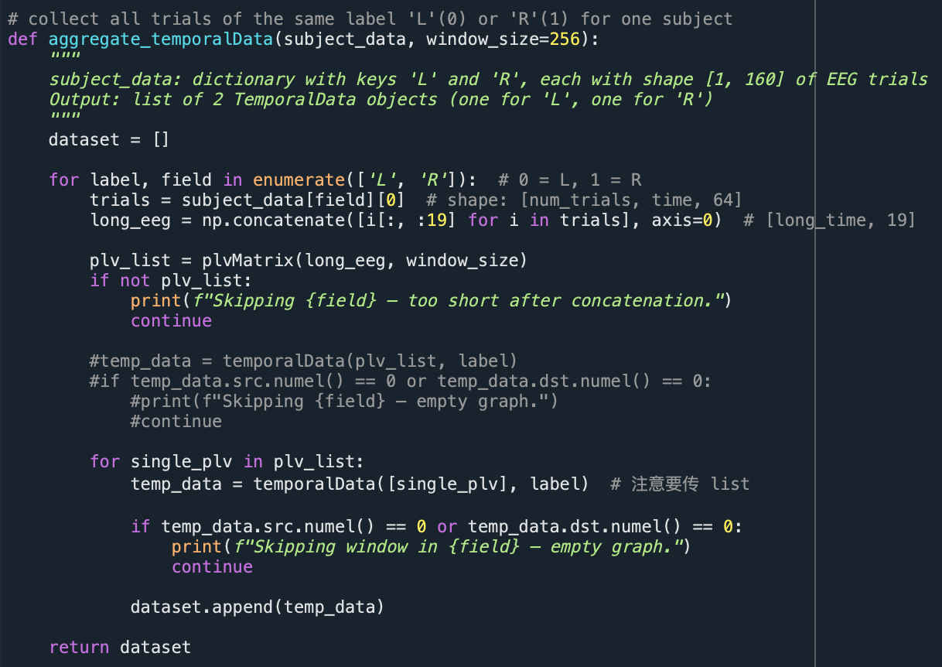
TGN Model Overview
‘aggregate_temporalData’ function
-> Concatenate all trials for one class (‘L’ or ‘R’) of one subject;
-> Slice them into equal-sized windows;
-> Each window gets a unique t index:
0, 1, 2, ..., N;
-> Convert each window to a TemporalData object with one label either ‘L’ or ‘R’.
Avoid the overlap of window indices and enables the TGN to learn temporal evolution over a longer continuous signal.
If window slicing is applied to each trial individually before concatenation, the temporal index t will reset for every trial.
t = 0, 1, 2 ‘trial 1 (L)’
t = 0, 1, 2, 3 ‘trial 2 (L)’
... ...
This breaks the temporal continuity assumption for Temporal Graph Networks,
which rely on globally ordered event streams to model information flow over time.

Slide 15
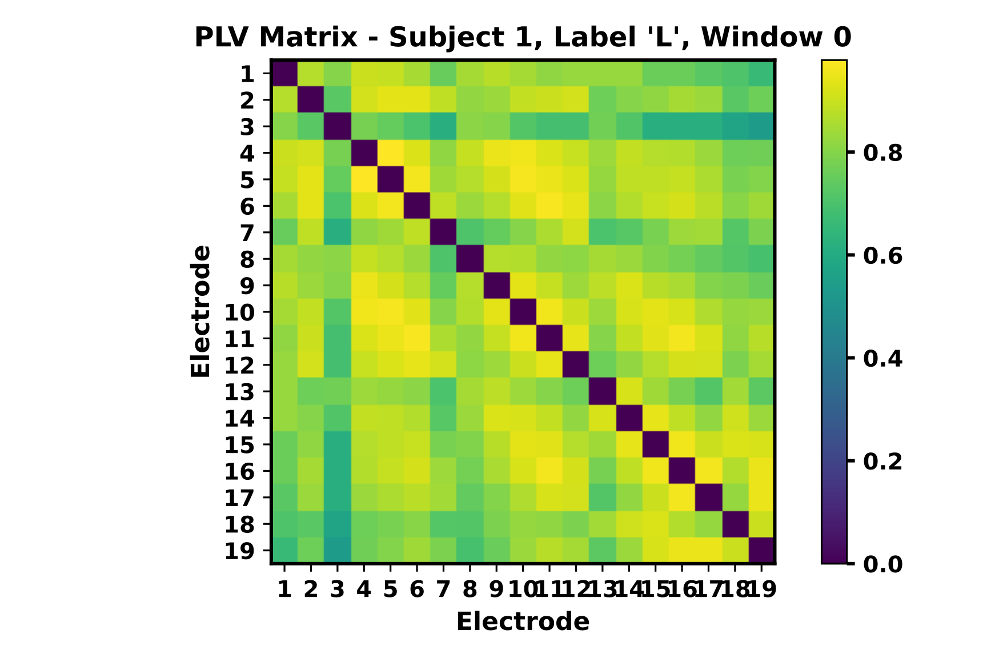
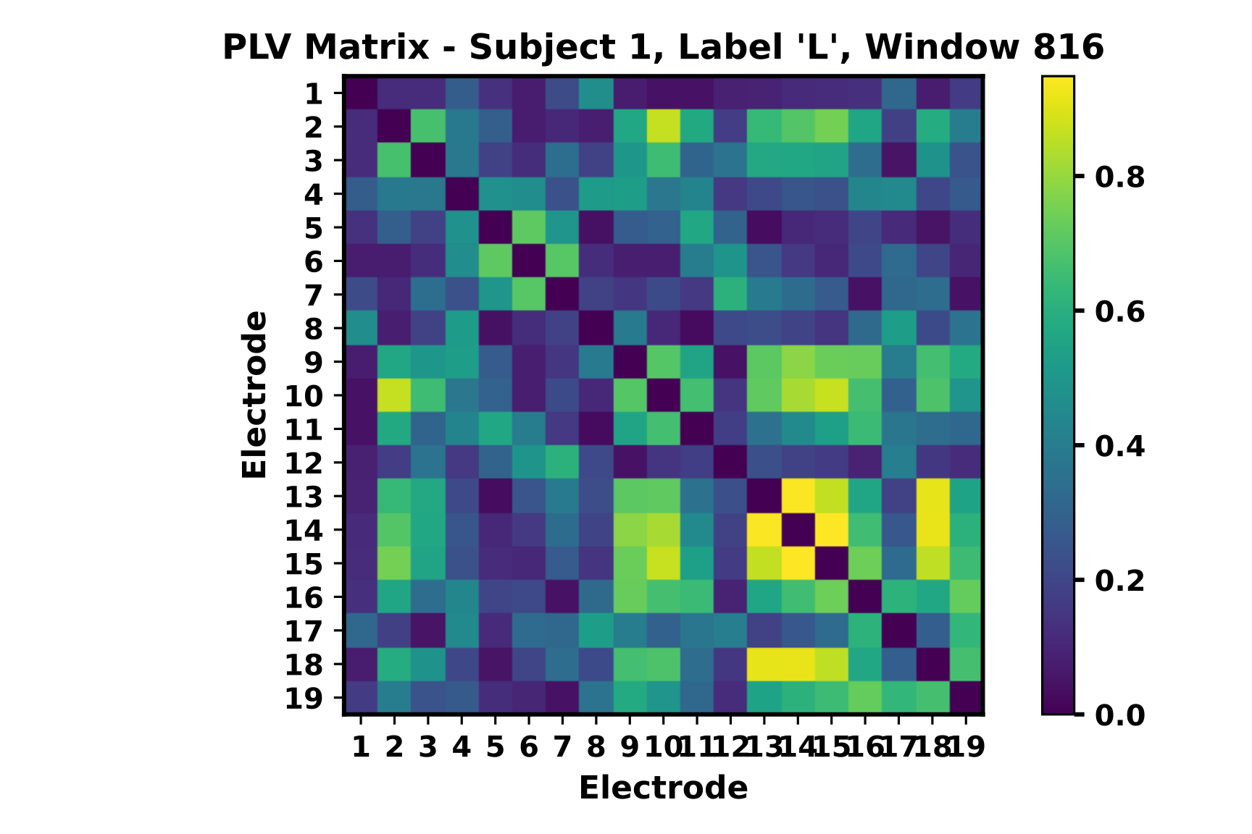
TGN Model Overview
one TemporalData object = one temporal graph = one window = one plvMatrix
= multiple events (src, dst, t, msg), where each event has its own src, dst, timestamp, msg.
Subject 1, Trial 1 (L)
Subject 1, All Trials (L)
Subject 1, All Trials (L)
Electrons
Electrons
Electrons
 | 1 | ... | 19
1
2
...
1288
1
2
...
1288
...
1
2
...
928
 | 1 | ... | 19
1
2
...
1288
1
2
...
1288
...
1
2
...
928
 | 1 | ... | 19
1
2
...
1288
Time
steps
Time
steps
‘TemporalData object 0’
Time
steps
events = TemporalData(
src=Tensor([1,2,3,4]),
dst=Tensor([2,3,4,5]),
t=Tensor([1000,1010,1100,2000]),
msg=Tensor([1,1,0,0]),
y = Tensor([1,1,0,0])
)
window 0
window 1
‘TemporalData object 1’
...
Subject 1, Trial 2 (L)
window 2
Subject 1, Trial 3 (L)
aggregate all trials of one class for each subject
window slicing, fixed window size = 256, i.e. each window = one second
...
...
...
window ...
...
Subject 1, Trial 160 (L)
...
...
Electrons
 | 1 | ... | 19
1
2
...
928
...
...
Time
steps
...
...
...
window n
‘TemporalData object n’
Notes:
1) aggregate all trials of a class (e.g., all ‘L’ trials for one subject)
2) slice that combined signal into windows, ensuring window indices (timestamps) are globally increasing — [0, 1, 2, ...] — across the entire class, not restarting for each trial.
3) one TemporalData object = one temporal graph = one window = one plvMatrix
= multiple events (src, dst, t, msg), where each event has its own src, dst, timestamp, msg.

Slide 16


TGN Model Overview
one TemporalData object = one temporal graph = one window = one plvMatrix
= multiple events (src, dst, t, msg), where each event has its own src, dst, timestamp, msg.
Subject 1, Trial 1 (L)
Subject 1, All Trials (L)
Electrons
Electrons
 | 1 | ... | 19
1
2
...
1288
1
2
...
1288
...
1
2
...
928
 | 1 | ... | 19
1
2
...
1288
Time
steps
‘TemporalData object 0’
Time
steps
events = TemporalData(
src=Tensor([1,2,3,4]),
dst=Tensor([2,3,4,5]),
t=Tensor([1000,1010,1100,2000]),
msg=Tensor([1,1,0,0]),
y = Tensor([1,1,0,0])
)
1-second
window 0
32 objects
as one batch
1-second
window 1
‘TemporalData object 1’
batch 0
...
Subject 1, Trial 2 (L)
1). aggregate all trials of one class for each subject;
2). window slicing, fixed window size = 256, i.e. each window = one second
1-second
window 2
‘TemporalData object 2’
Subject 1, Trial 3 (L)
...
TGN Model
...
...
...
Input
...
1-second
window ...
...
Subject 1, Trial 160 (L)
...
...
Electrons
 | 1 | ... | 19
1
2
...
928
...
Time
steps
...
...
...
...
batch m
1-second
window n
‘TemporalData object n’
Notes:
1) aggregate all trials of a class (e.g., all ‘L’ trials for one subject)
2) slice that combined signal into windows, ensuring window indices (timestamps) are globally increasing — [0, 1, 2, ...] — across the entire class, not restarting for each trial.
3) one TemporalData object = one temporal graph = one window = one plvMatrix
= multiple events (src, dst, t, msg), where each event has its own src, dst, timestamp, msg.

Slide 17
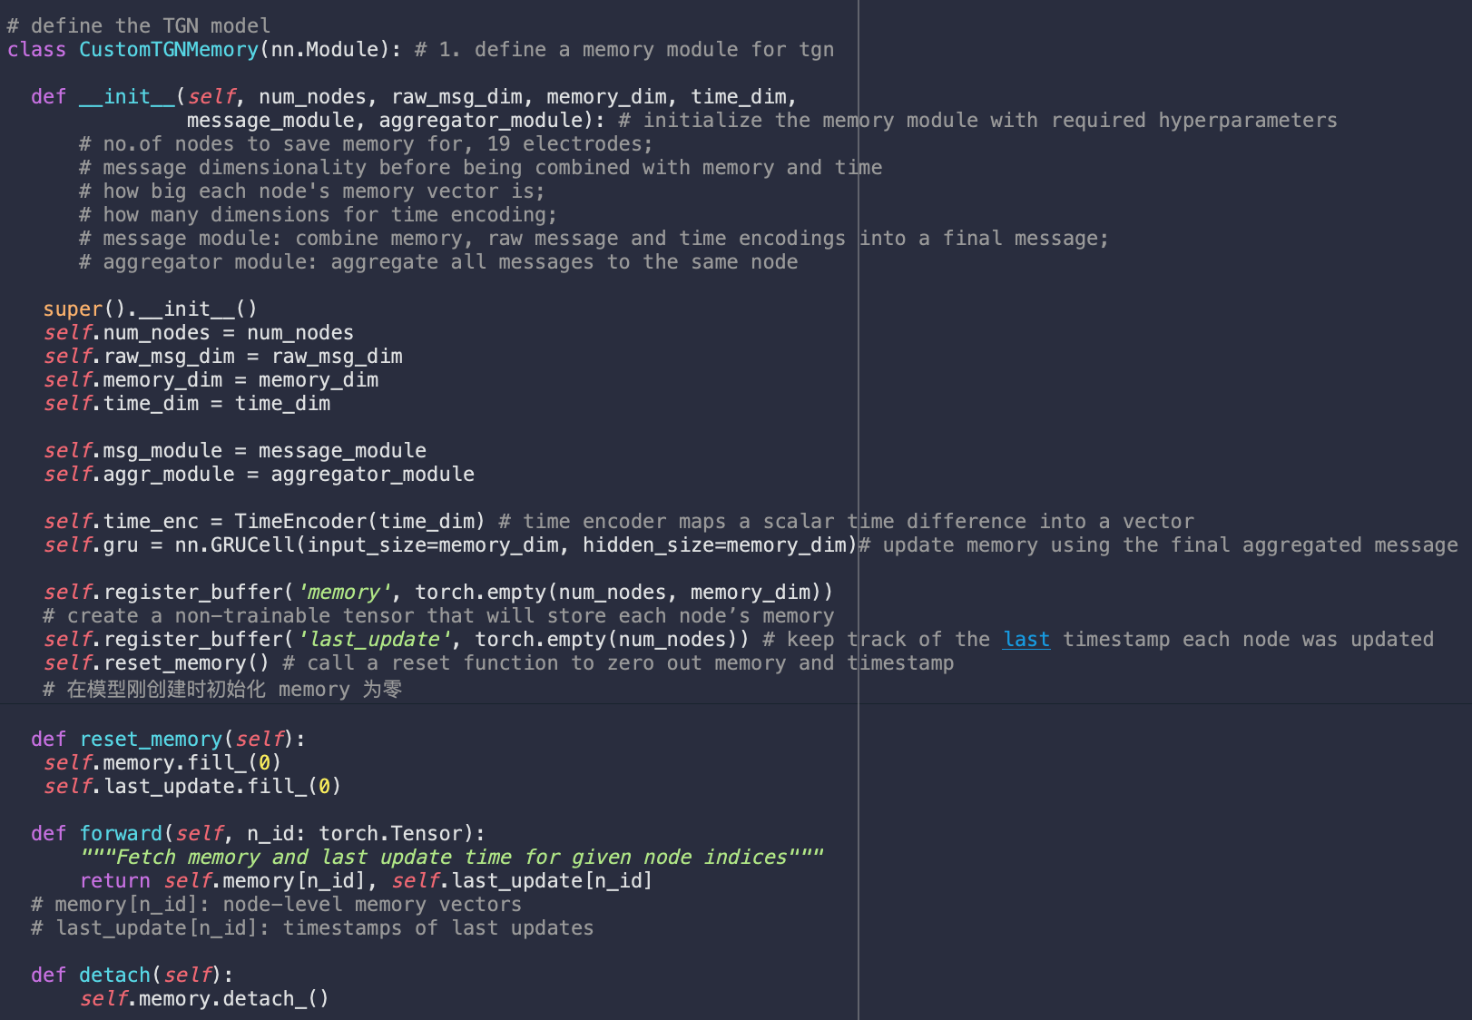
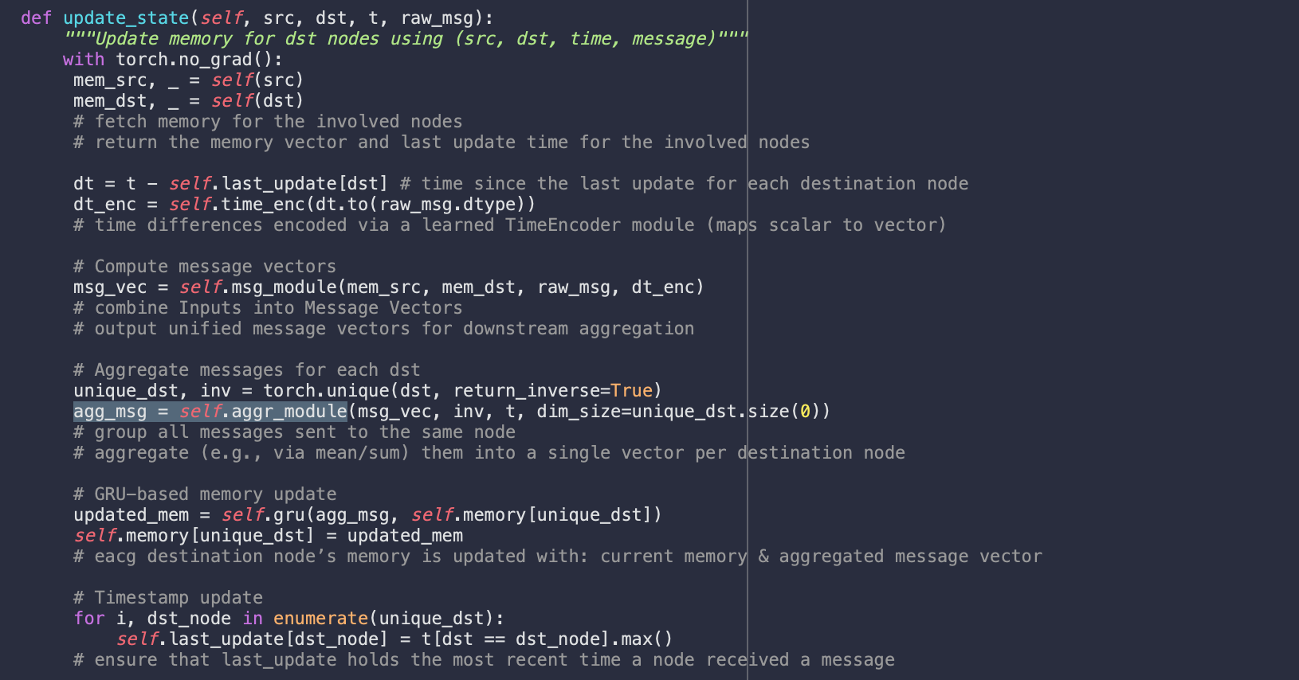
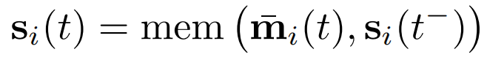
TGN Model Overview
‘CustomTGNMemory’ class
-> implement the TGN memory module, responsible for updating node’s memory based on messages, and then saving as a time-aware state memory for dynamic graph learning;
-> ‘__init__’ func: initialize the memory module with required hyperparameters, submodules, and persistent memory;
-> ‘reset_memory’ func: reset node memories and timestamps to zero for each subject/fold, preventing leakage from past state;
-> ‘forward’ func: retrieve memory state and last update time for specified node indices, so update modules can read node state during temporal learning;
-> ‘detach’ func: break gradient flow from current memory to prior batches, to prevent backpropagation through outdated memory states across mini-batches or time steps;
-> ‘update_state’ func: update node memory states and timestamps using temporal message passing.
TimeEncoder: encode ∆t into vectors
GRUCell: updates node memory
memory & last update buffers, NOT trainable
memory buffer: stores node memory states;
last_update buffer: stores last update timestamps
https://pytorch-geometric.readthedocs.io/en/latest/_modules/torch_geometric/nn/models/tgn.html#TGNMemory
https://pytorch geometric.readthedocs.io/en/latest/generated/torch_geometric.nn.models.TGNMemory.html#torch_geometric.nn.models.TGNMemory
Notes:
In PyTorch, a buffer is a persistent tensor registered to a module that is saved and loaded with the model, but not updated via gradient descent. Buffers are commonly used for storing stateful variables such as running statistics, memory vectors, or timestamps.

Slide 18
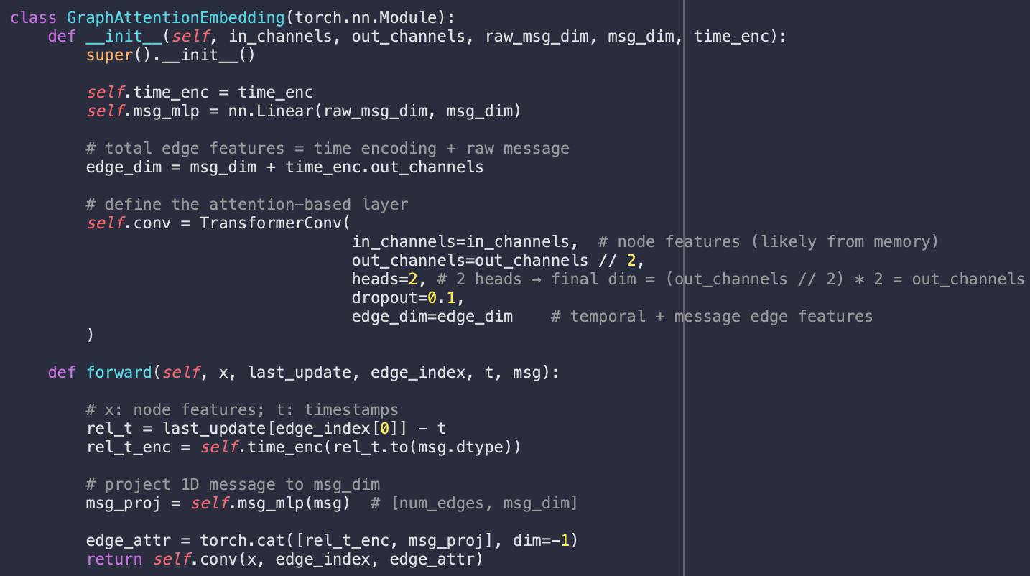
TGN Model Overview
‘GraphAttentionEmbedding’ class
-> implement the TGN embedding module, using the Temporal Graph Attention version ;
-> ‘__init__’ func: 1) set up a linear transformation layer that projects raw EEG plv scalar into a higher-dimensional message vector for downstream attention learning; 2) define a 2-head temporal graph attention layer that incorporates both temporal and message features on edges, enabling dynamic neighbor weighting during message aggregation;
-> ‘forward’ func: apply attention-based convolution over the graph using edge features, producing node embeddings that capture both the temporal context and the semantic content of incoming messages.
perform attention-guided message propagation from neighbors, producing a spatiotemporal embedding for each node.
edge features
(1-d plv scalar)
edge features
(high-dim vector: message+time)
Linear Layer
raw message + Δt encoding
TransformConv
Layer
(heads =2)
node embedding
(spatial-temporal vector in higher dimension)
node features
(memory vector)
weighted by attention scores
https://github.com/pyg-team/pytorch_geometric/blob/master/examples/tgn.py#L31
Notes:
graph attention encoder: embed temporal graph data
(attention) heads = 2: two people see/观察 the input channels

Slide 19
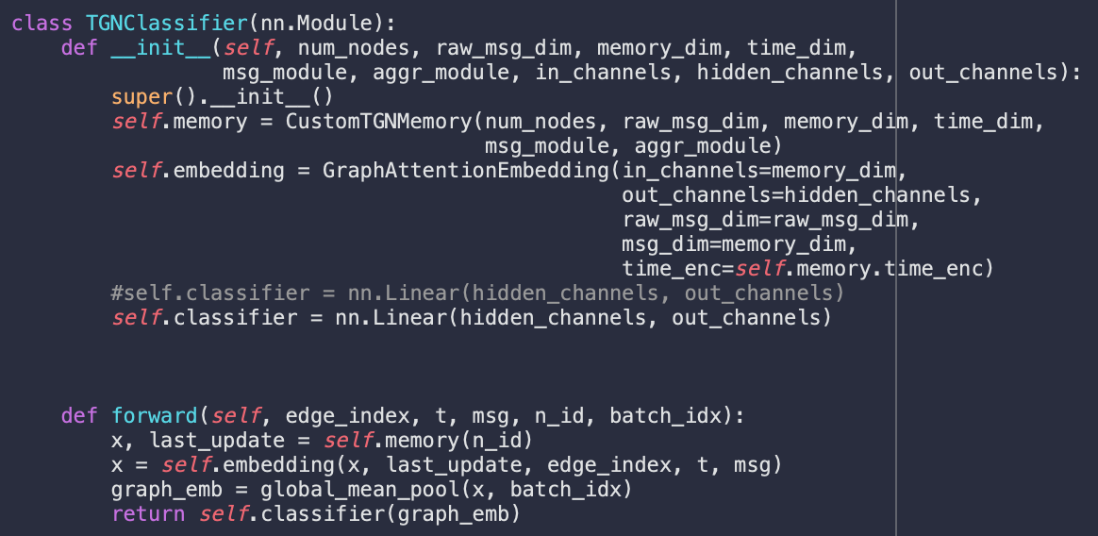
TGN Model Overview
‘TGNClassifier’ class
-> implement the top-level TGN model for motor imagery prediction based on EEG temporal graphs;
-> ‘__init__’ func: 1) set up the memory module to track temporal states of each node; 2) use GraphAttentionEmbedding module to encode node memory features into attention-based node embeddings; 3) add a linear classifier to map graph-level features to final graph predictions.
-> ‘forward’ func: 1) apply global mean pooling to get a graph-level vector; 2) predict class ‘L’ or ‘R’ using the final linear layer.
one graph-level representation (vector)
binary prediction (‘L’ or ‘R’ motor imagery)
node embedding
Global Mean Pooling Layer
Linear Classifier Layer
Notes:
linear classifier: predict motor imagery labels (L/R) from graph representations.
global mean pool: non-learnable readout layer in graph neural networks, get ready for graph prediction.

Slide 20
TGN Model Overview
CustomTGNMemory
new event e_{ij}(t) or v_{i}(t)
learnable message function msg
output
m_{i}(t)
...
...
aggregation
function agg
output
past memory s_{i}(t⁻)
m_{i}(t)
memory updator mem
output
updated memory s_{i}(t)
used to update node i’s memory
for multiple events involving the same node i in the same batch
s_{i}(t⁻)
node features
(memory vector)
node embedding
(spatial-temporal vector in higher dimension)
binary prediction (‘L’or ‘R’ motor imagery)
Linear Classifier Layer
one graph-level representation (vector)
Global Mean Pooling Layer
TransformConv
Layer
(heads =2)
edge features
(high-dim vector: message+time)
edge features
(1-d plv scalar)
Linear Layer
weighted by attention scores
raw message + Δt encoding
TGNClassifier
GraphAttentionEmbedding

Slide 21
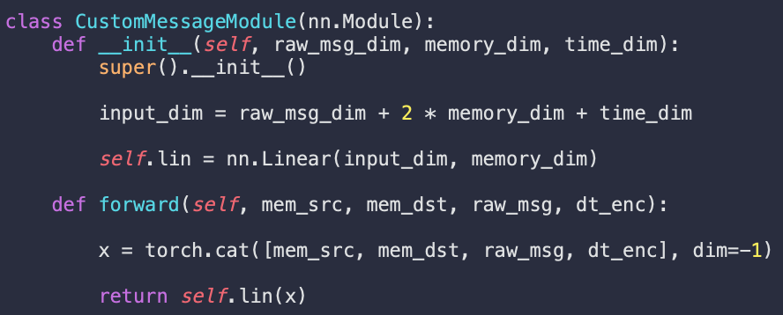
TGN Model Overview
‘CustomMessageModule’ class
-> implement the TGN message module, responsible for constructing temporal messages by combining node memories, raw features, and time encodings;
-> ‘__init__’ func: define a linear transformation layer that maps the concatenated message input (source memory, destination memory, raw message, and encoded Δt) into a fixed-size message vector of the same dimensionality as the memory;
-> ‘forward’ func: concatenate mem_src, mem_dst, raw_msg, and dt_enc along the feature dimension, then apply the linear layer to output the final message vector for memory update.

Slide 22
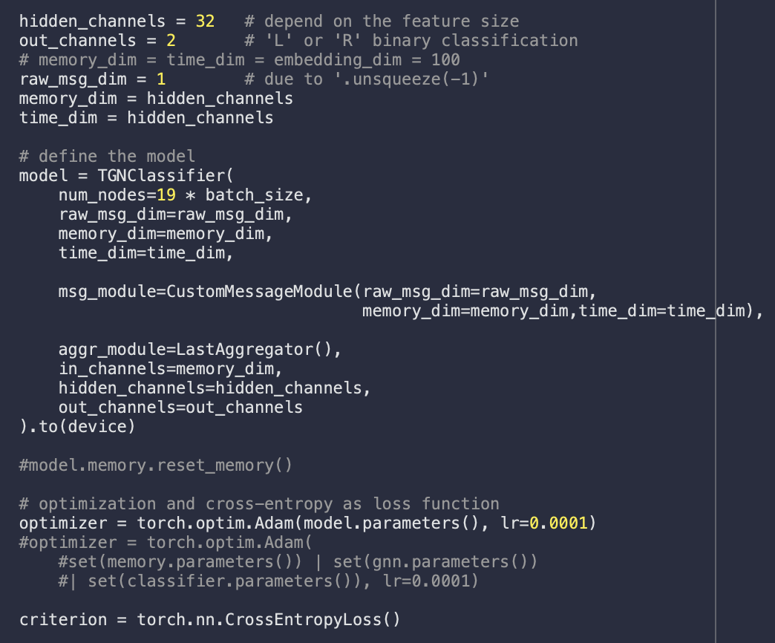
TGN Model Overview
Hyperparameter settings
-> memory vector of each node
= time encoding vector
= input edge feature vector
= hidden channel/layer = 32;
Model - ‘TGNClassifier’
-> build the complete TGN architecture for EEG motor imagery classification;
-> use CustomMessageModule (defined previously) to encode raw messages;
-> apply LastAggregator to select the latest message for each node;
Optimizer - ‘Adam optimizer’
-> update model parameters, with learning rate 0.0001;
Criterion - ‘cross entropy loss function’
-> compute the difference between predicted probability distribution and true class labels, to drive gradient descent during training and guide parameter updates through backpropagation.
simplify the architecture & avoid extra projection layers
be manually set and tuned based on model performance
large enough to capture rich temporal features, but small enough to avoid overfitting and heavy computation
$$Cross Entropy L = −log(‘Predicted’ Prob L)$$
Notes:
hyperparameters: be manually set by human and tune them, not optimize them via gradient descent.

Slide 23
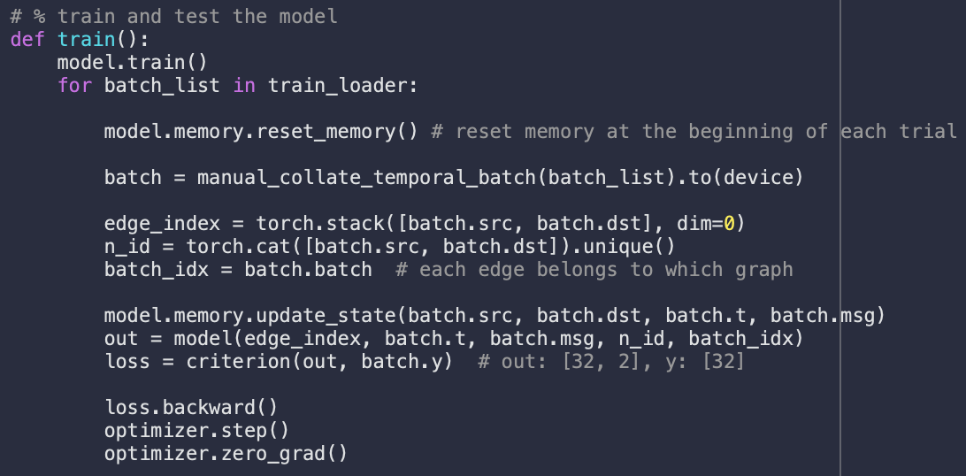
TGN Model Overview
‘train’ function
-> put model in training mode;
-> convert a list of TemporalData into a single batched graph;
-> perform forward pass to obtain logits for binary classification;
-> compute loss using cross entropy function, quantifying the difference between predicted logits and ground truth labels;
-> compute gradients;
-> update weights;
-> reset gradients before next batch.
update memory for each batch
Backpropagation:
1. forward pass - obtain model output;
2. loss computation;
3. backward pass - compute loss;
4. weights update;
5. zero gradients.

Slide 24
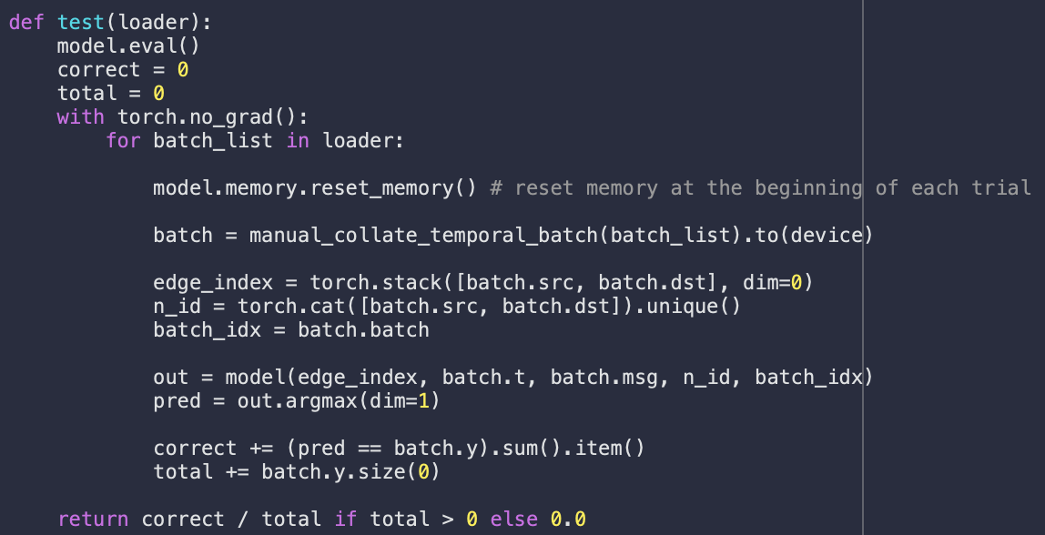
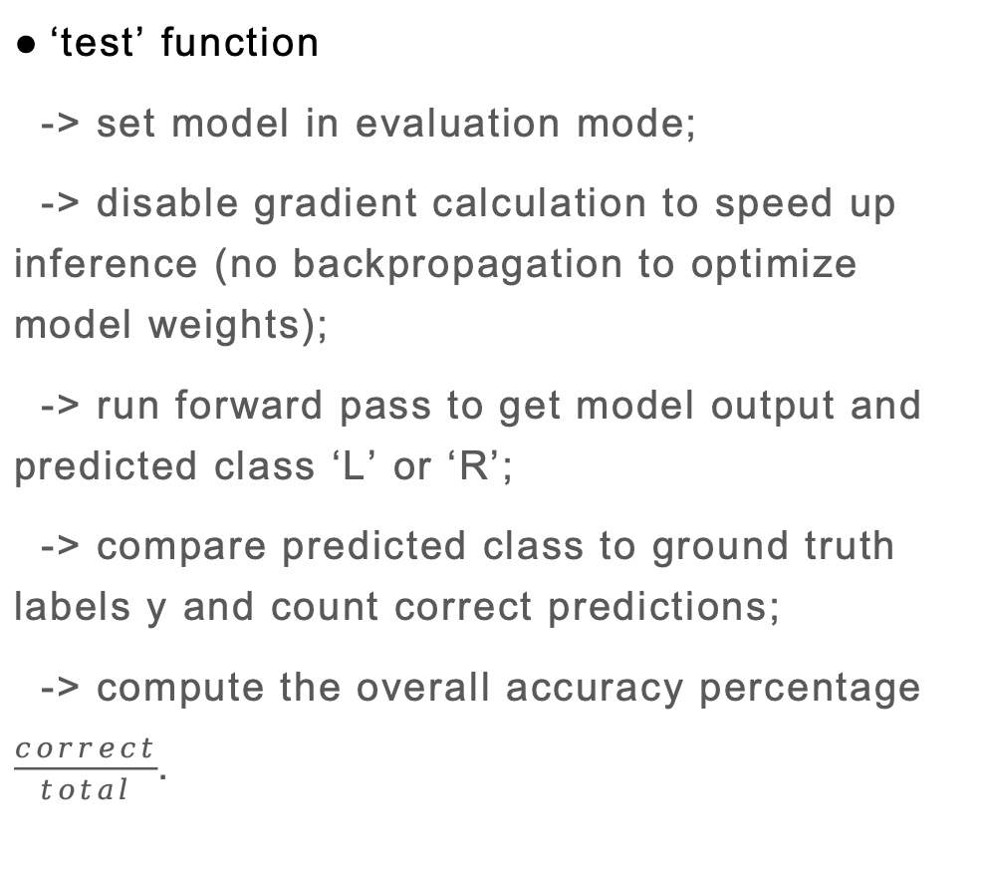
TGN Model Overview
‘test’ function
-> set model in evaluation mode;
-> disable gradient calculation to speed up inference (no backpropagation to optimize model weights);
-> run forward pass to get model output and predicted class ‘L’ or ‘R’;
-> compare predicted class to ground truth labels y and count correct predictions;
-> compute the overall accuracy percentage $\frac{correct}{total}$.

Slide 25
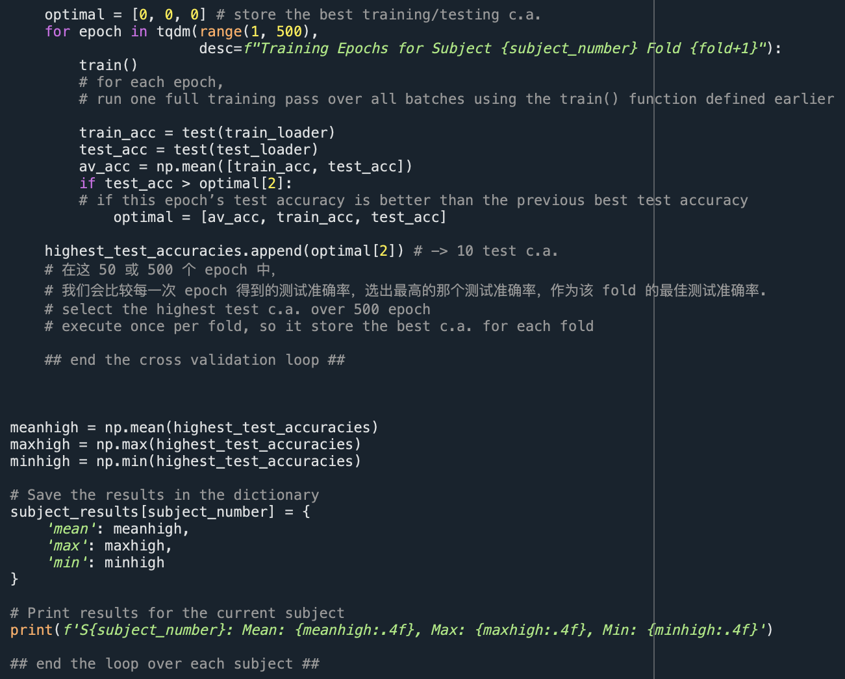
TGN Model Overview
Epoch loop
-> train the model once per epoch to update model weights;
-> evaluate training and test accuracy after each epoch;
Accuracy tracking
-> after all epochs, only save results for the epoch with the highest test c.a. as the optimal c.a. for that fold;
-> go over each fold, obtain optimal c.a. for each fold;
-> calculate mean, max, min over 10 folds for the current subject;
Notes:
loop over each subject -> subject-specific training -> the model is subject-independent/subject-wise - > one model per subject

Slide 26

TGN Model Overview
one TemporalData object = one temporal graph = one window = one plvMatrix
= multiple events (src, dst, t, msg), where each event has its own src, dst, timestamp, msg.
test
train
‘L’
1-sec window
fold 1
‘R’
1-sec window
1 batch = 32 EEG windows
fold 1
fold 1
fold 1
fold 1
fold 1
fold 1
fold 1
fold 1
fold 1
...
...
...
fold 2
...
fold 2
fold 2
fold 2
fold 2
fold 2
fold 2
fold 2
fold 2
fold 2
‘L’
1-sec window
...
fold 3
In one epoch:
feed all training windows once,
update model weights once;
obtain one value of train c.a.
model see test windows once,
obtain one value of test c.a.
fold 3
fold 3
fold 3
fold 3
fold 3
fold 3
fold 3
fold 3
fold 3
fold 4
‘L’
1-sec window
fold 4
fold 4
fold 4
fold 4
fold 4
fold 4
fold 4
fold 4
fold 4
fold 5
‘R’
1-sec window
1 batch
fold 5
fold 5
fold 5
fold 5
fold 5
fold 5
fold 5
fold 5
fold 5
10 test c.a. for each fold being as test set
all 1-sec windows (graphs), from all trials & both class of one subject
...
...
one epoch
fold 6
...
fold 6
fold 6
fold 6
fold 6
fold 6
fold 6
fold 6
fold 6
fold 6
‘L’
1-sec window
fold 7
1 batch
fold 7
fold 7
fold 7
fold 7
fold 7
fold 7
fold 7
fold 7
fold 7
...
fold 8
‘L’
1-sec window
fold 8
fold 8
fold 8
fold 8
fold 8
fold 8
fold 8
fold 8
fold 8
...
fold 9
‘R’
1-sec window
fold 9
fold 9
fold 9
fold 9
fold 9
fold 9
fold 9
fold 9
fold 9
...
...
fold 10
...
1 batch
fold 10
fold 10
fold 10
fold 10
fold 10
fold 10
fold 10
fold 10
fold 10
‘L’
1-sec window
$$500 epochs$$
pick up the optimal epoch with highest test c.a.
[train_ca, test_ca, avg] when fold 1 is test set
Notes:
10-fold cross-validation: subject-wise evaluation.
data being split: all 1-second windows (graphs), from all trials and both classes, of one subject.
If a subject has 820 valid windows total (e.g., 410 from 'L', 410 from 'R'), each fold has ~82 windows used for testing, and the rest (~738) for training.
One batch = 32 separate EEG windows (i.e., graphs), each one second long.
Batch size of 32 -> it splits the training windows into mini-batches of 32 windows/graphs each.
Pass through all training windows once; the model sees each window only once per epoch; after one full pass: epoch done ✅.

Slide 27
TGN Model Overview
one TemporalData object = one temporal graph = one window = one plvMatrix
= multiple events (src, dst, t, msg), where each event has its own src, dst, timestamp, msg.
test
train
‘L’
1-sec window
fold 1
‘R’
1-sec window
1 batch = 32 EEG windows
fold 1
fold 1
fold 1
fold 1
fold 1
fold 1
fold 1
fold 1
fold 1
...
...
...
fold 2
...
fold 2
fold 2
fold 2
fold 2
fold 2
fold 2
fold 2
fold 2
fold 2
‘L’
1-sec window
...
fold 3
fold 3
fold 3
fold 3
fold 3
fold 3
fold 3
fold 3
fold 3
fold 3
fold 4
‘L’
1-sec window
fold 4
fold 4
fold 4
fold 4
fold 4
fold 4
fold 4
fold 4
fold 4
fold 5
‘R’
1-sec window
1 batch
fold 5
fold 5
fold 5
fold 5
fold 5
fold 5
fold 5
fold 5
fold 5
10 test c.a. for each fold being as test set
mean, max, min c.a. for the current subject
...
one epoch
...
all 1-sec windows (graphs), from all trials & both class of one subject
fold 6
...
fold 6
fold 6
fold 6
fold 6
fold 6
fold 6
fold 6
fold 6
fold 6
‘L’
1-sec window
fold 7
1 batch
fold 7
fold 7
fold 7
fold 7
fold 7
fold 7
fold 7
fold 7
fold 7
...
fold 8
‘L’
1-sec window
fold 8
fold 8
fold 8
fold 8
fold 8
fold 8
fold 8
fold 8
fold 8
...
fold 9
‘R’
1-sec window
fold 9
fold 9
fold 9
fold 9
fold 9
fold 9
fold 9
fold 9
fold 9
...
...
fold 10
...
1 batch
fold 10
fold 10
fold 10
fold 10
fold 10
fold 10
fold 10
fold 10
fold 10
‘L’
1-sec window
$$500 epochs$$
pick up the optimal epoch with highest test c.a.
[train_ca, test_ca, avg] when fold 1 is test set
Notes:
loop over each subject, so the model is subject-independent/subject-wise
one epoch (all batches), and then backpropagation once

Slide 28
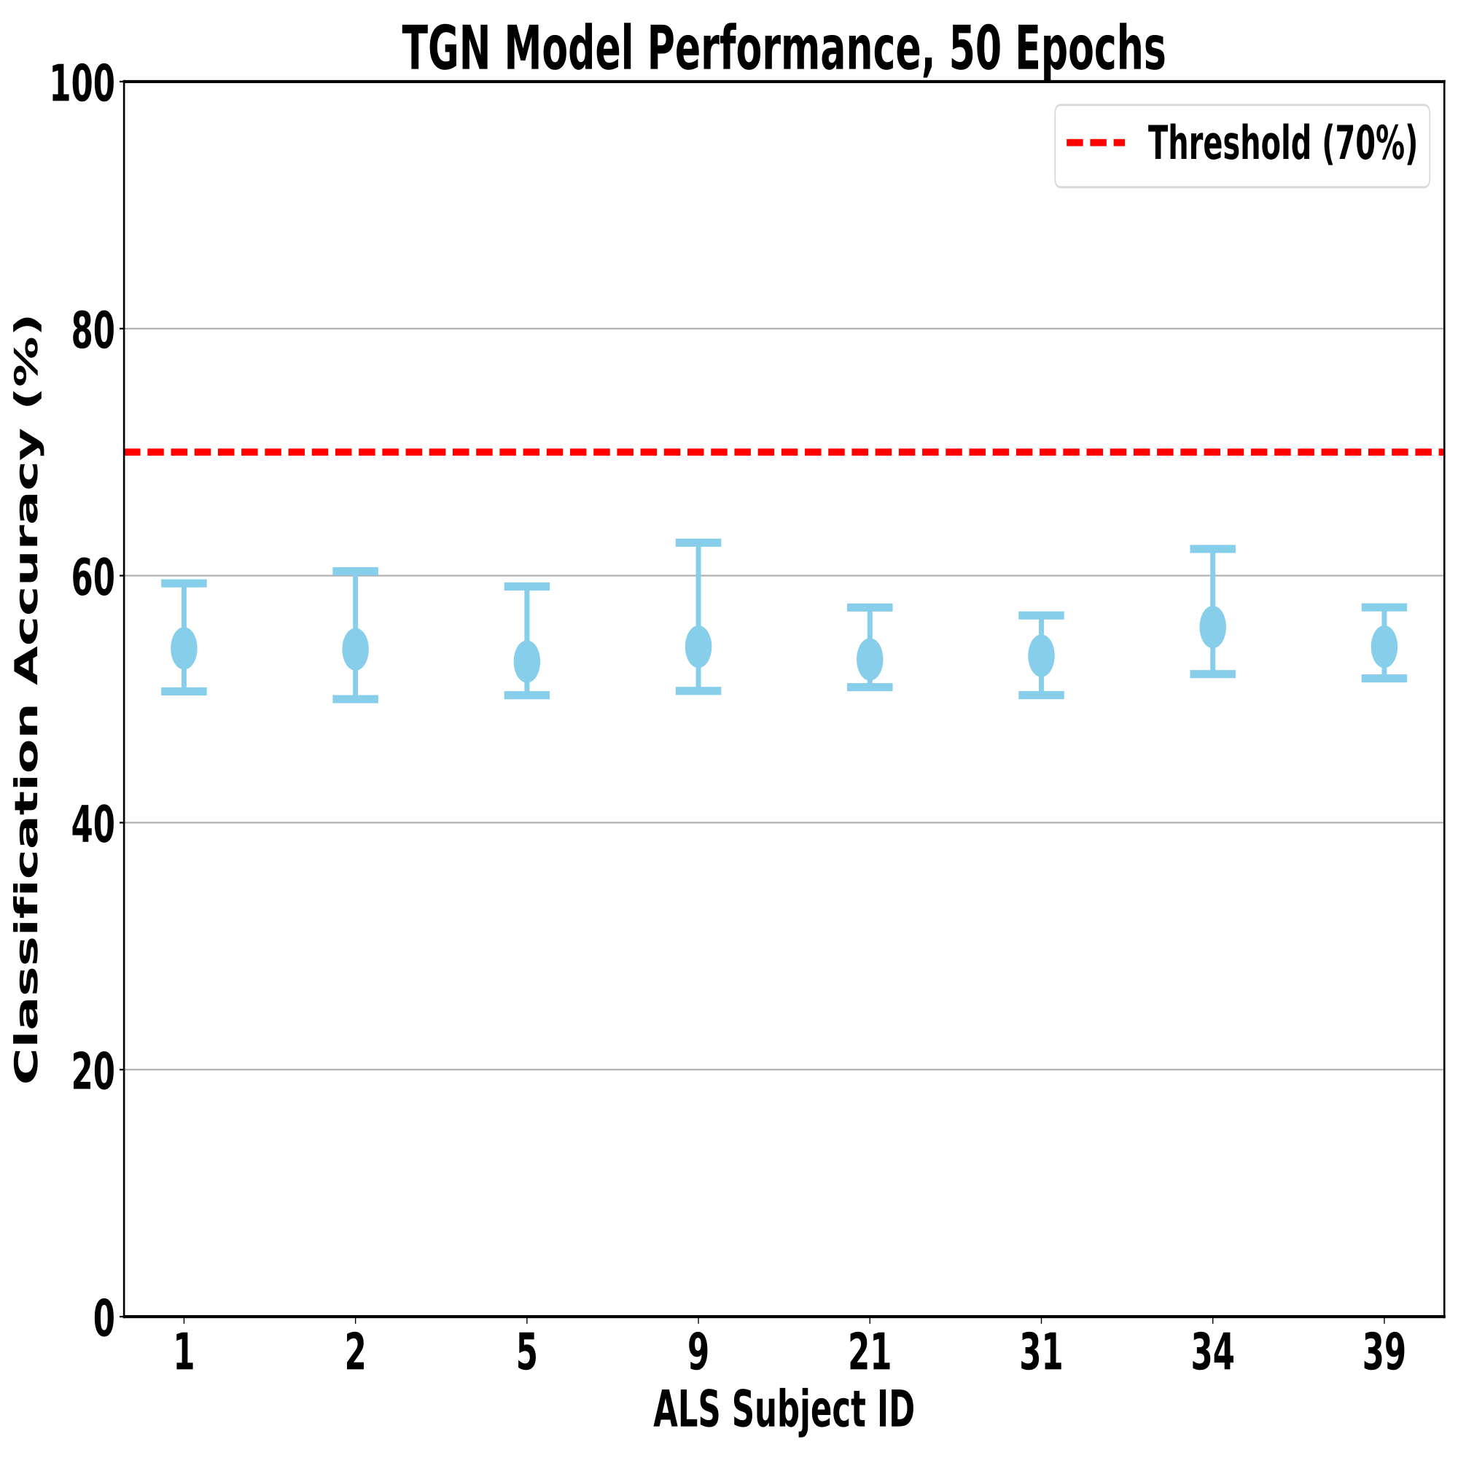
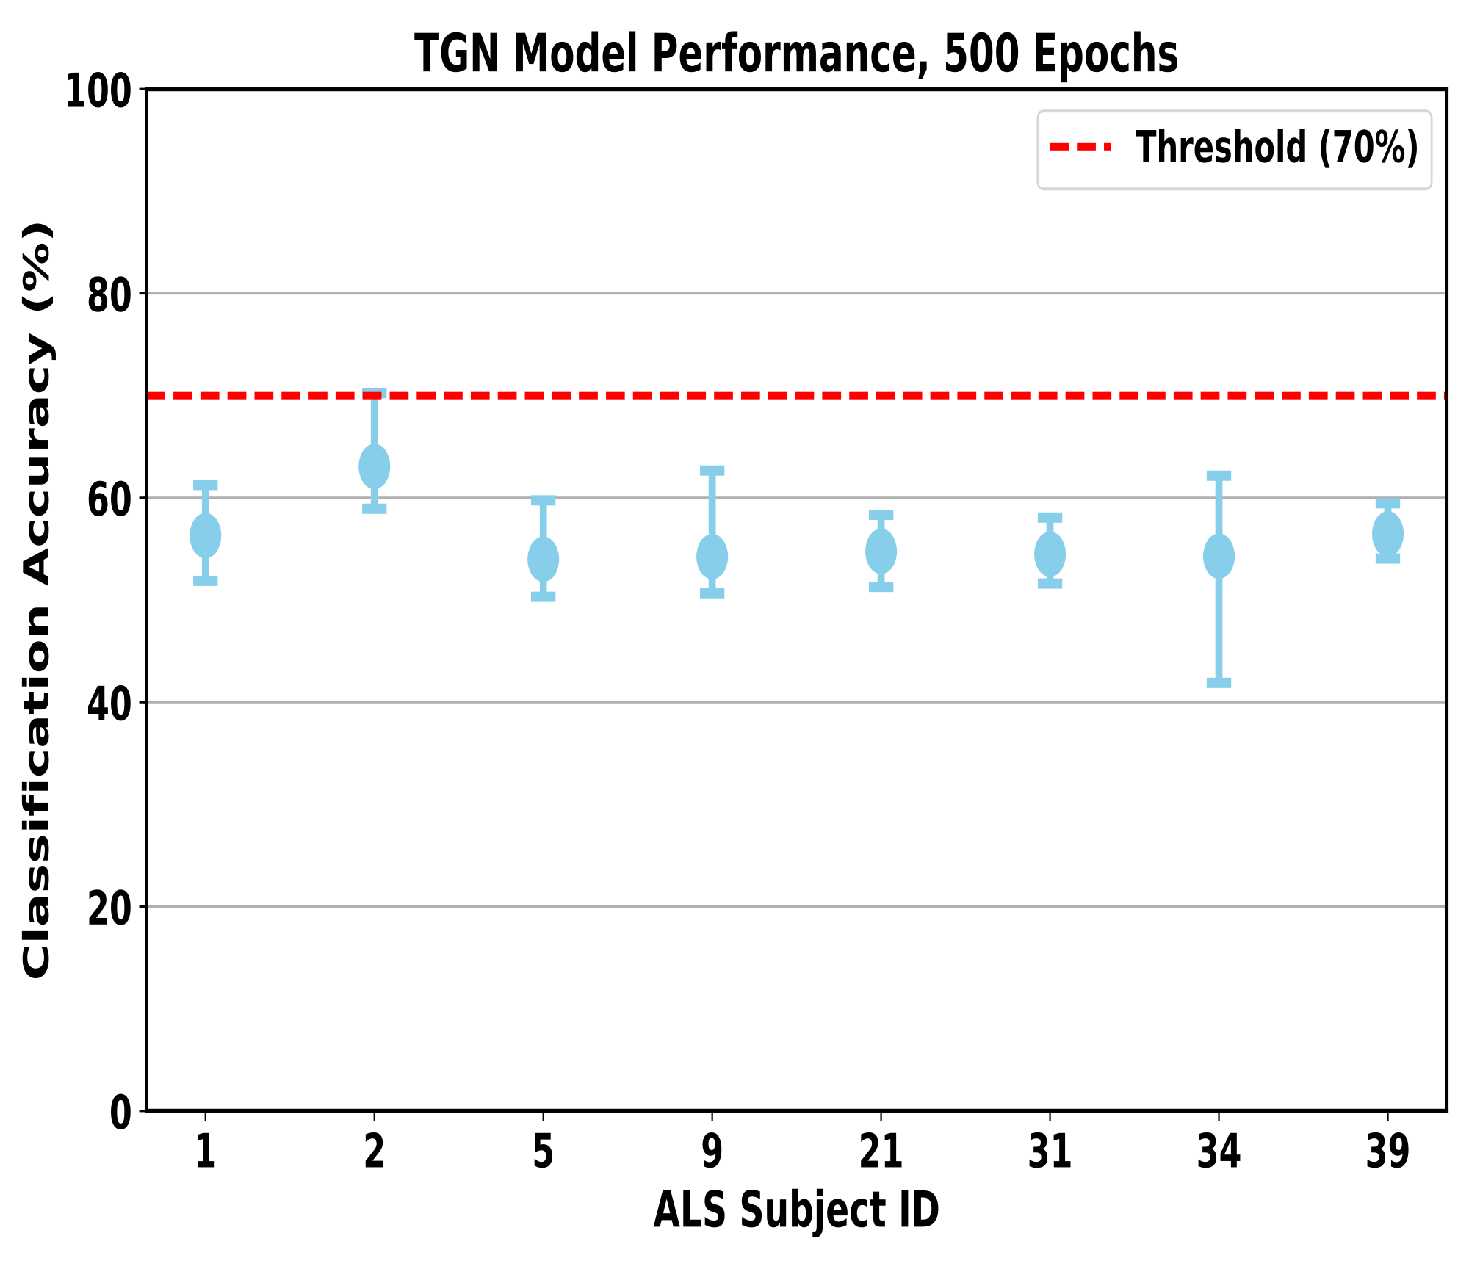
TGN Model - 50 vs. 500 Epoch
No Significant Difference Between 50 And 500 Epochs
-> have extracted most useful features, i.e. model has converged before 50 epochs;
-> more epochs do improve mean c.a. values, but not much, so no overfitting occurs (stable model);
-> although the TGN model does make a stat. sig. difference between 50 and 500 epochs;
-> the model difference is probably caused by random noise/fluctuation;
-> so keep 50 epochs for local trial runs, impove model by tuning other hyperparameters.
 | p values
Wilcoxon test | 0.0156 (<0.05)
Paired t-test | 0.0168 (<0.05)
paired t-test/Wilcoxon test?
(p > 0.05: no statistically significant difference)
Notes:
Wilcoxon signed-rank test null hypothesis: the median difference between the paired observations is zero
(a large p-value: the observed difference could have arisen from random variation)
Friedman test: a non-parametric statistical test used to compare three or more related samples (not applicable here, only have two samples to compare)

Slide 29
TGN Model - Improvement
Window-Slicing Strategy Modification:
-> shorter window size: degrade edge feature quality, i.e. the average quantiy plv becomes susceptible to noise. EEG stationarity within trials, so using a longer window helps produce a more reliable PLV estimate;
-> larger window size: smooth out/merge signal dynamics, could missing potentially meaningful edge features;
-> increase window size to 3 seconds & overlap 1 seconds, in order for the model to see continuous features.
-> apply snap-to-end method, to avoid missing the final segments that fall short of a full window stride, ensuring complete and continuous EEG input.
window size trade-off
feed continuous features to model
1-sec
1-sec
1-sec
2-sec stride
3-sec window
3-sec window
Notes:
EEG signals are stationary during one trial (but non-stationary across sessions)
用 snap-to-end：完全覆盖整段 EEG；最后一步的间隔变成“尾巴长度”，TGN 能通过我们提供的真实时间戳感知这种轻微的不等间隔，时间并不“断”。

Slide 30
TGN Model - Improvement
Data Processing Modification
-> feed all windows with same index (e.g. all window 0) of all subjects to the model simultaneously, to achieve cross-subject model adaptation;
-> plv = log() to make edge feature smoother;
-> change edge threshold to plv threshold > 0, rejecting potential feature noises.
S1 all trials
window 0
window 1
window 2
...
S2 all trials
window 0
window 1
window 2
...
S3 all trials
window 0
window 1
window 2
...
...
window 0
window 1
window 2
...
W0
W1
W2
...
TGN Model

Slide 31
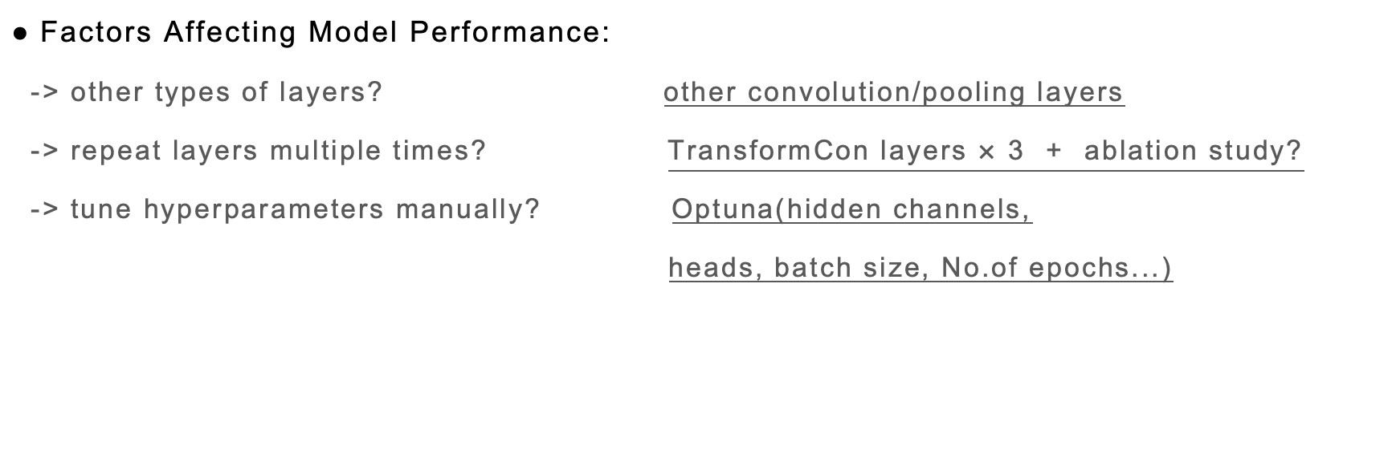
TGN Model - Improvement
Factors Affecting Model Performance:
-> other types of layers? other convolution/pooling layers
-> repeat layers multiple times? TransformCon layers $×$ 3 + ablation study?
-> tune hyperparameters manually? Optuna(hidden channels,
heads, batch size, No.of epochs...)
https://pytorch-geometric.readthedocs.io/en/latest/modules/nn.html#convolutional-layers
reject redundancy in EEG data, avoid overfitting?
https://github.com/optuna/optuna

Slide 32
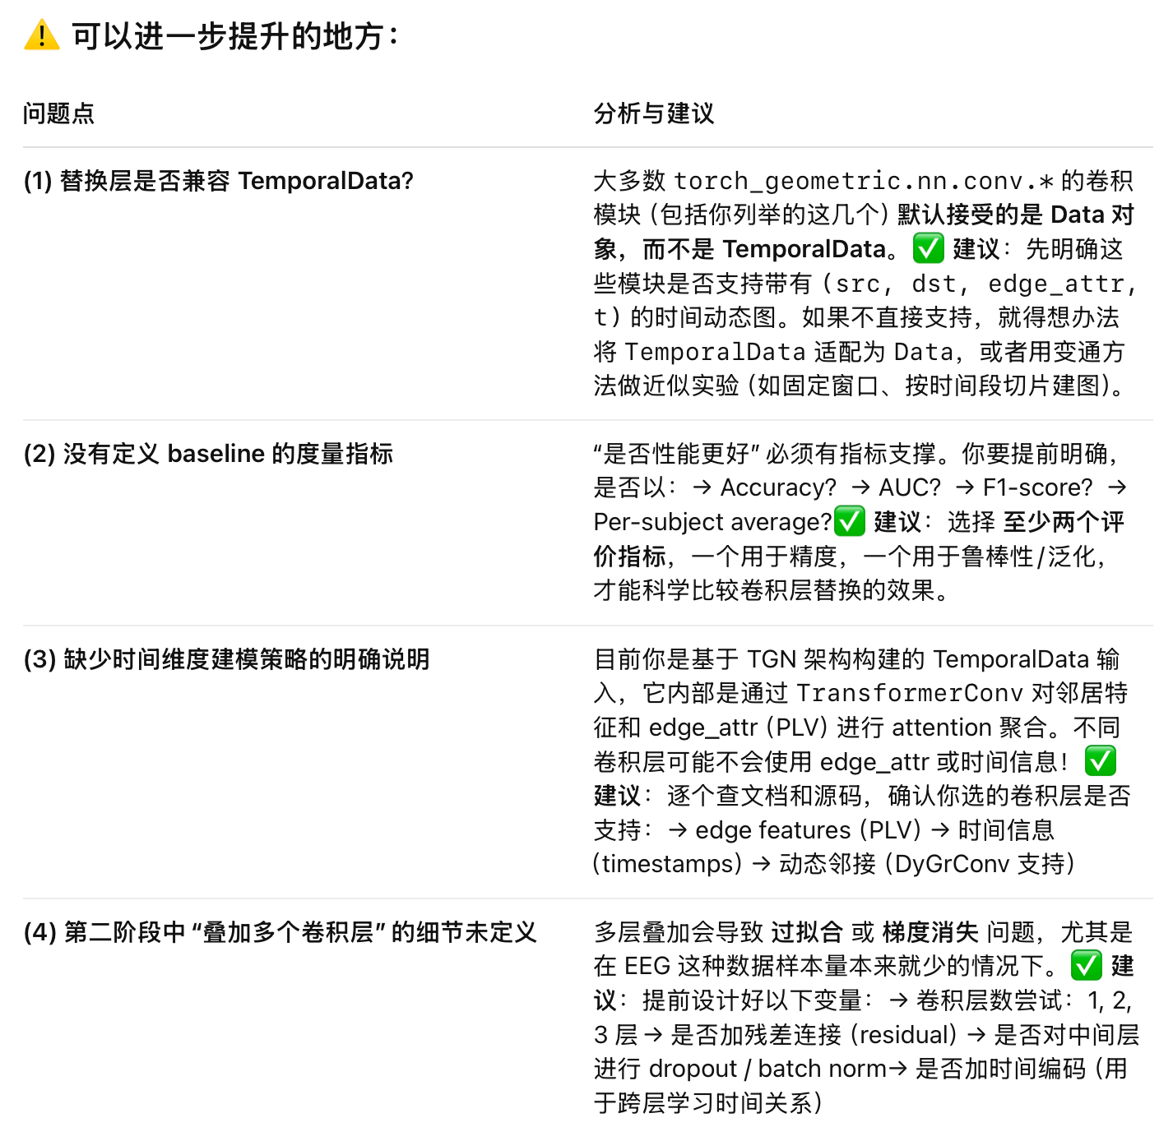
TGN Model - Improvement

Slide 33
Conference Writing Conception
TGN vs. GAT
-> TGN的TemporalData数据性质解决了哪些GAT无法解决的non-stationarity问题？
-> TGN独特的处理数据的方式/数据性质 treat EEG signals in a new way, providing an unique perspective to process EEG signals, making it possible to observe special features/properties, potentially new discoveries in neuroscience...
Modified TGN vs. state-of-the-art deep learning methods
-> show overall/mean c.a. improved & c.a. variance reduced;
-> faster model built-up;

Slide 34
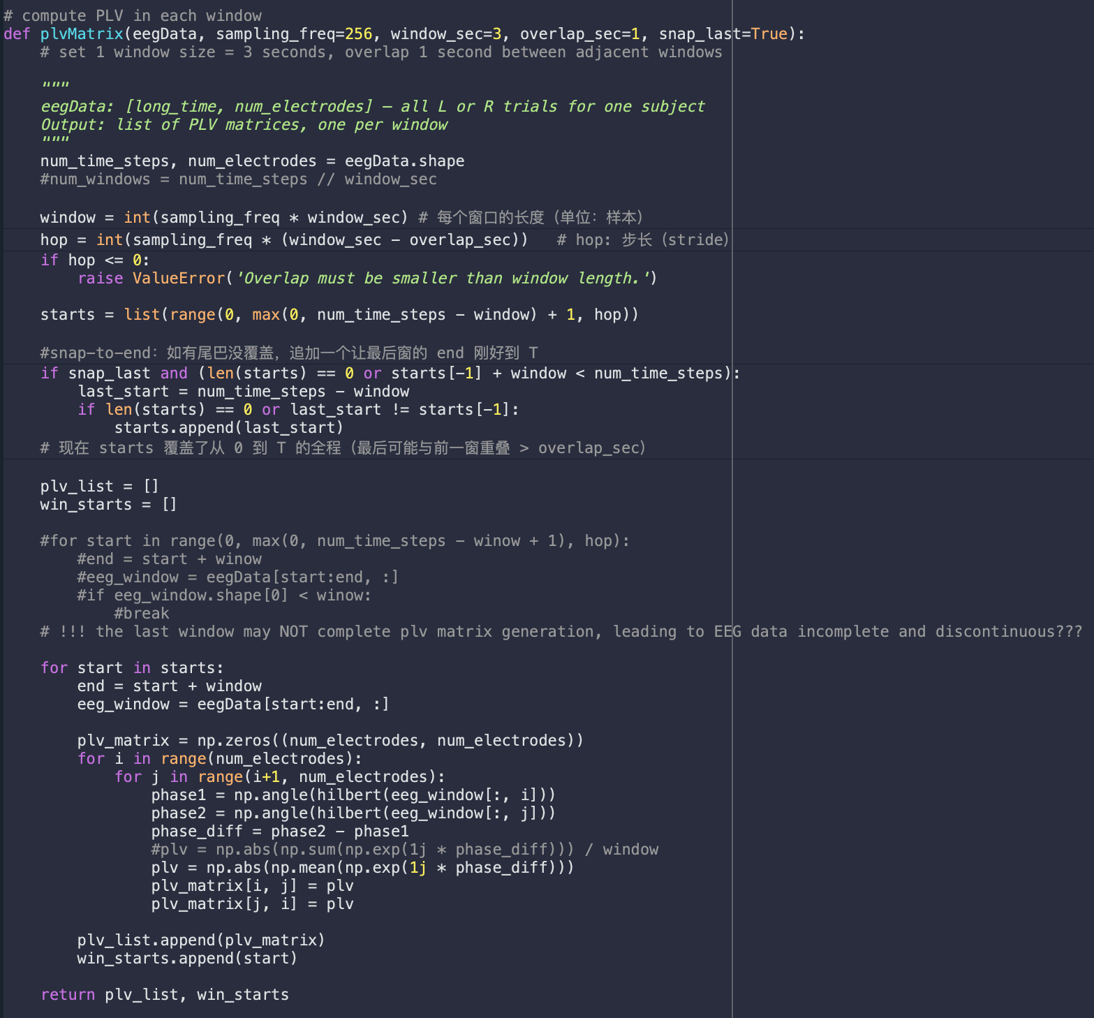
TGN Model - Improvement I: Window Overlapping
Step 1: Replace plvMatrix with an overlapped version (returns timestamps)

Slide 35
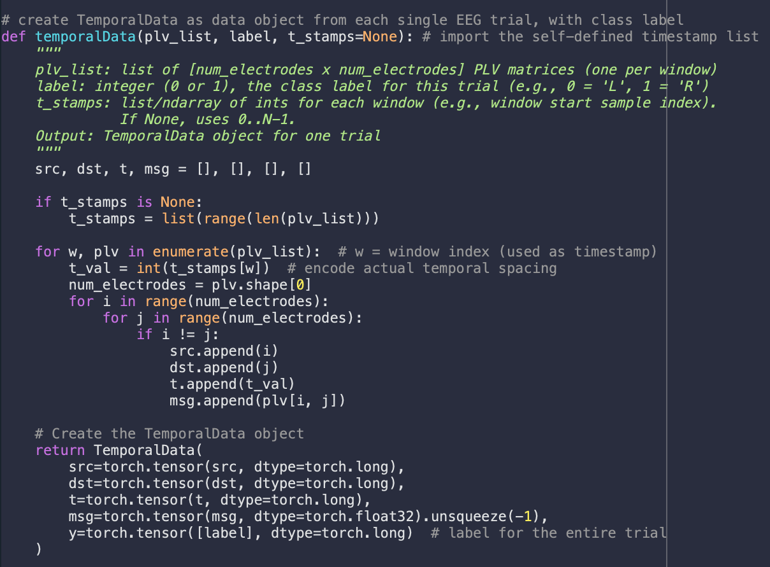
TGN Model - Improvement I: Window Overlapping
Step 2: Make temporalData accept real timestamps (so TGN “feels” continuity)

Slide 36
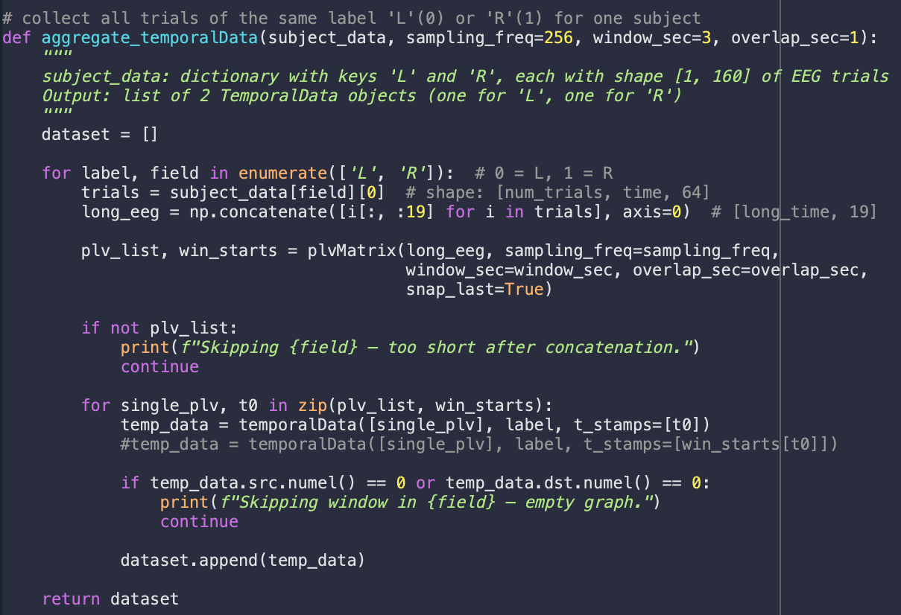
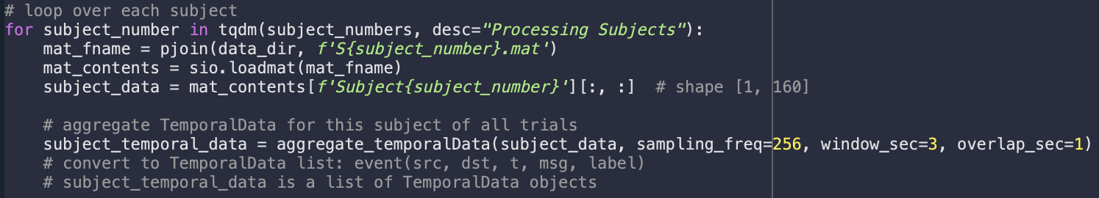
TGN Model - Improvement I: Window Overlapping
Step 3: Update the aggregation step to call the new API
Step 4: Pass the new parameters that are built in the per-subject dataset

Slide 37
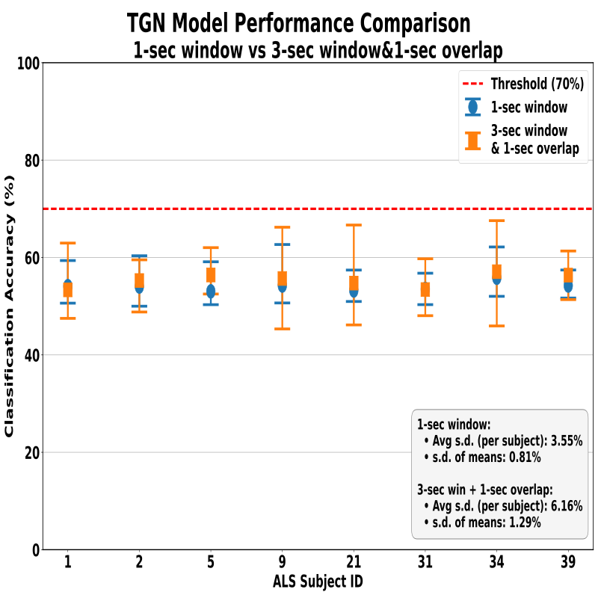
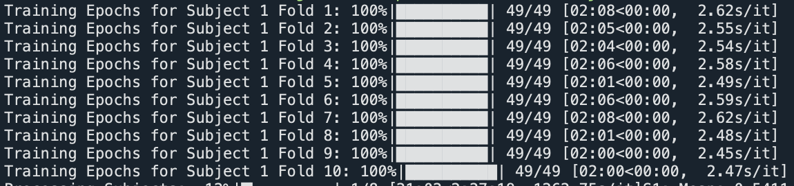
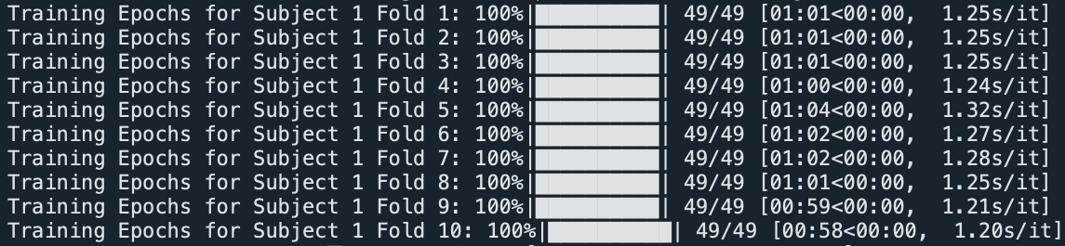
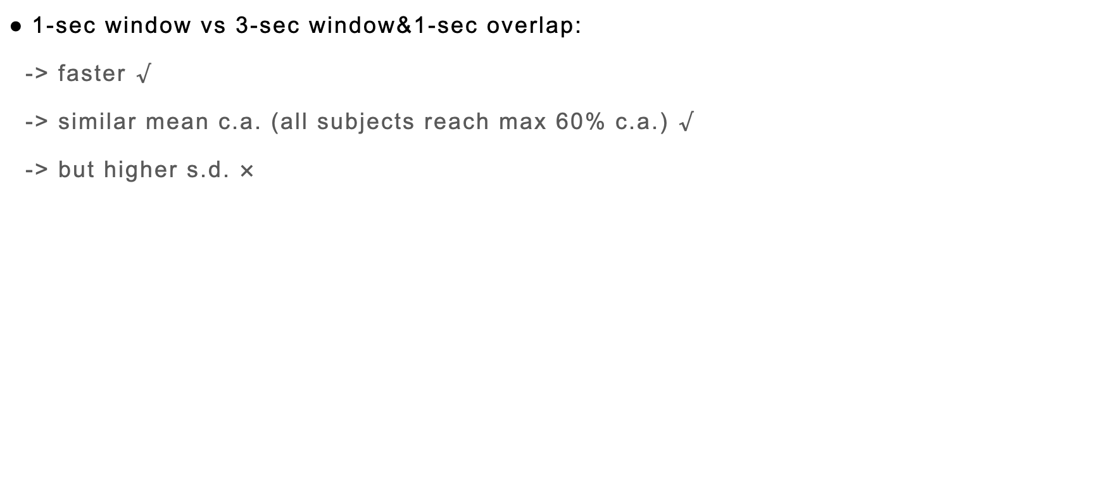
TGN Model - Improvement I: Window Overlapping
1-sec window vs 3-sec window&1-sec overlap:
-> faster $√$
-> similar mean c.a. (all subjects reach max 60% c.a.) $√$
-> but higher s.d. $×$
Notes:
Per-subject variability：对每个 subject 分别计算其 (mean, max, min) 的标准差;
Across-subject variability：对所有 subject 的 mean accuracy 计算标准差

Slide 38
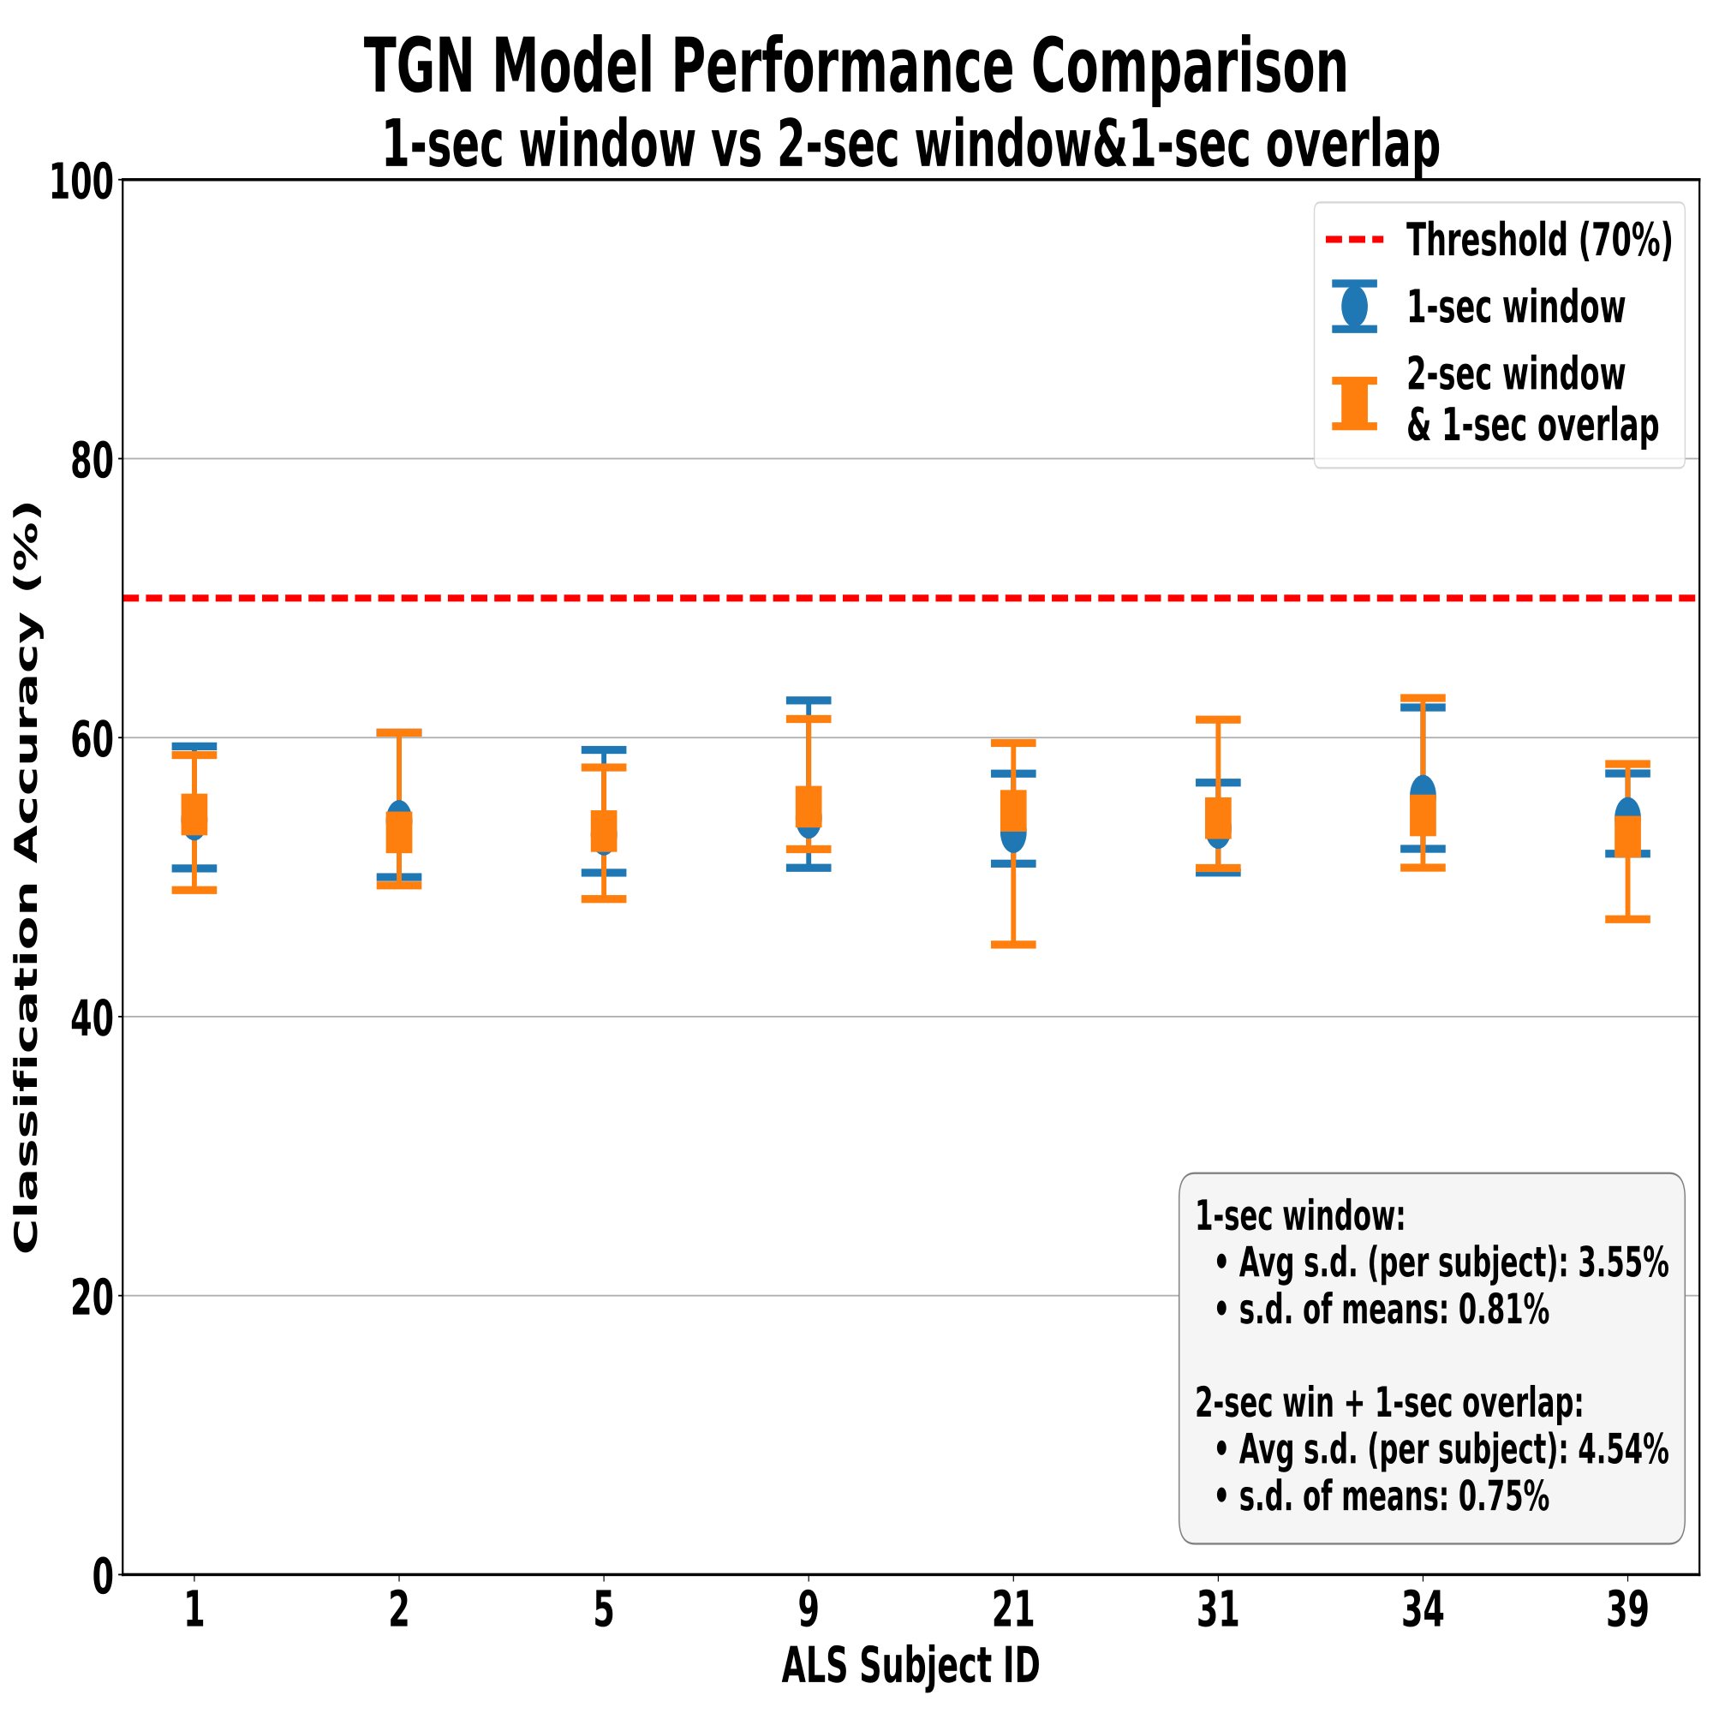
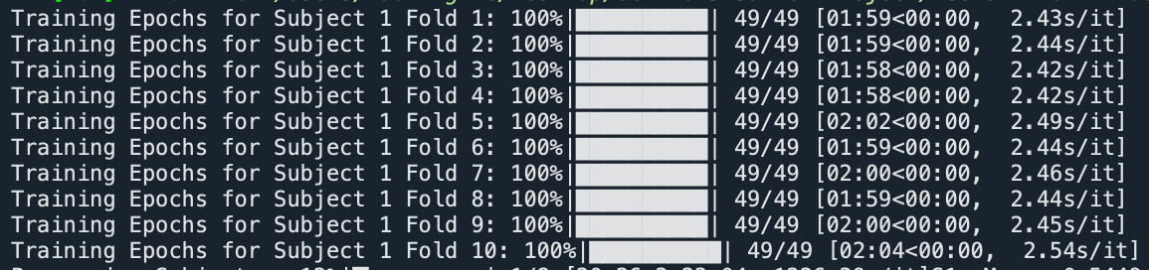
TGN Model - Improvement I: Window Overlapping
1-sec window vs 2-sec window&1-sec overlap:
-> same speed
-> similar mean c.a. (all subjects reach max 60% c.a.)
-> similar s.d.

Slide 39
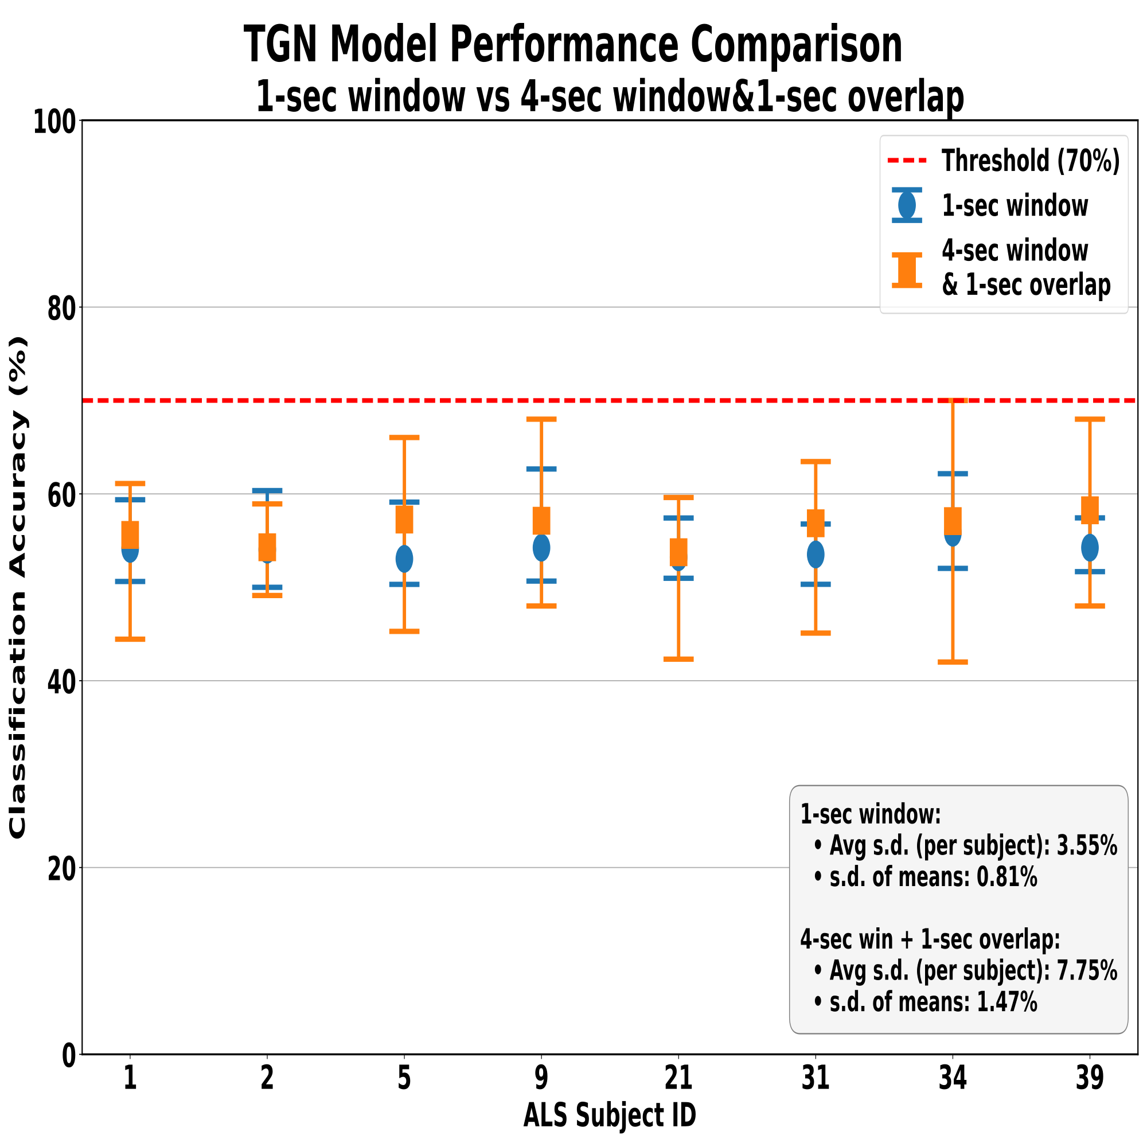
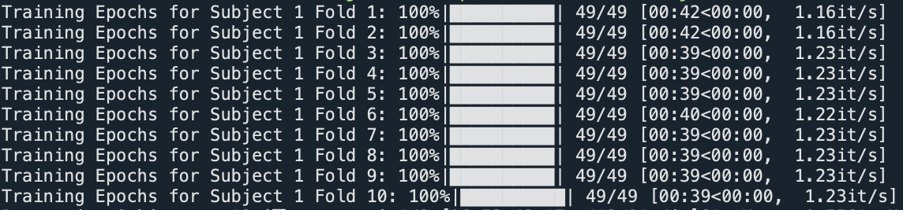
TGN Model - Improvement I: Window Overlapping
1-sec window vs 4-sec window&1-sec overlap:
-> faster
-> higher mean c.a. (all subjects reach 60% c.a. for max)
-> but higher s.d.

Slide 40
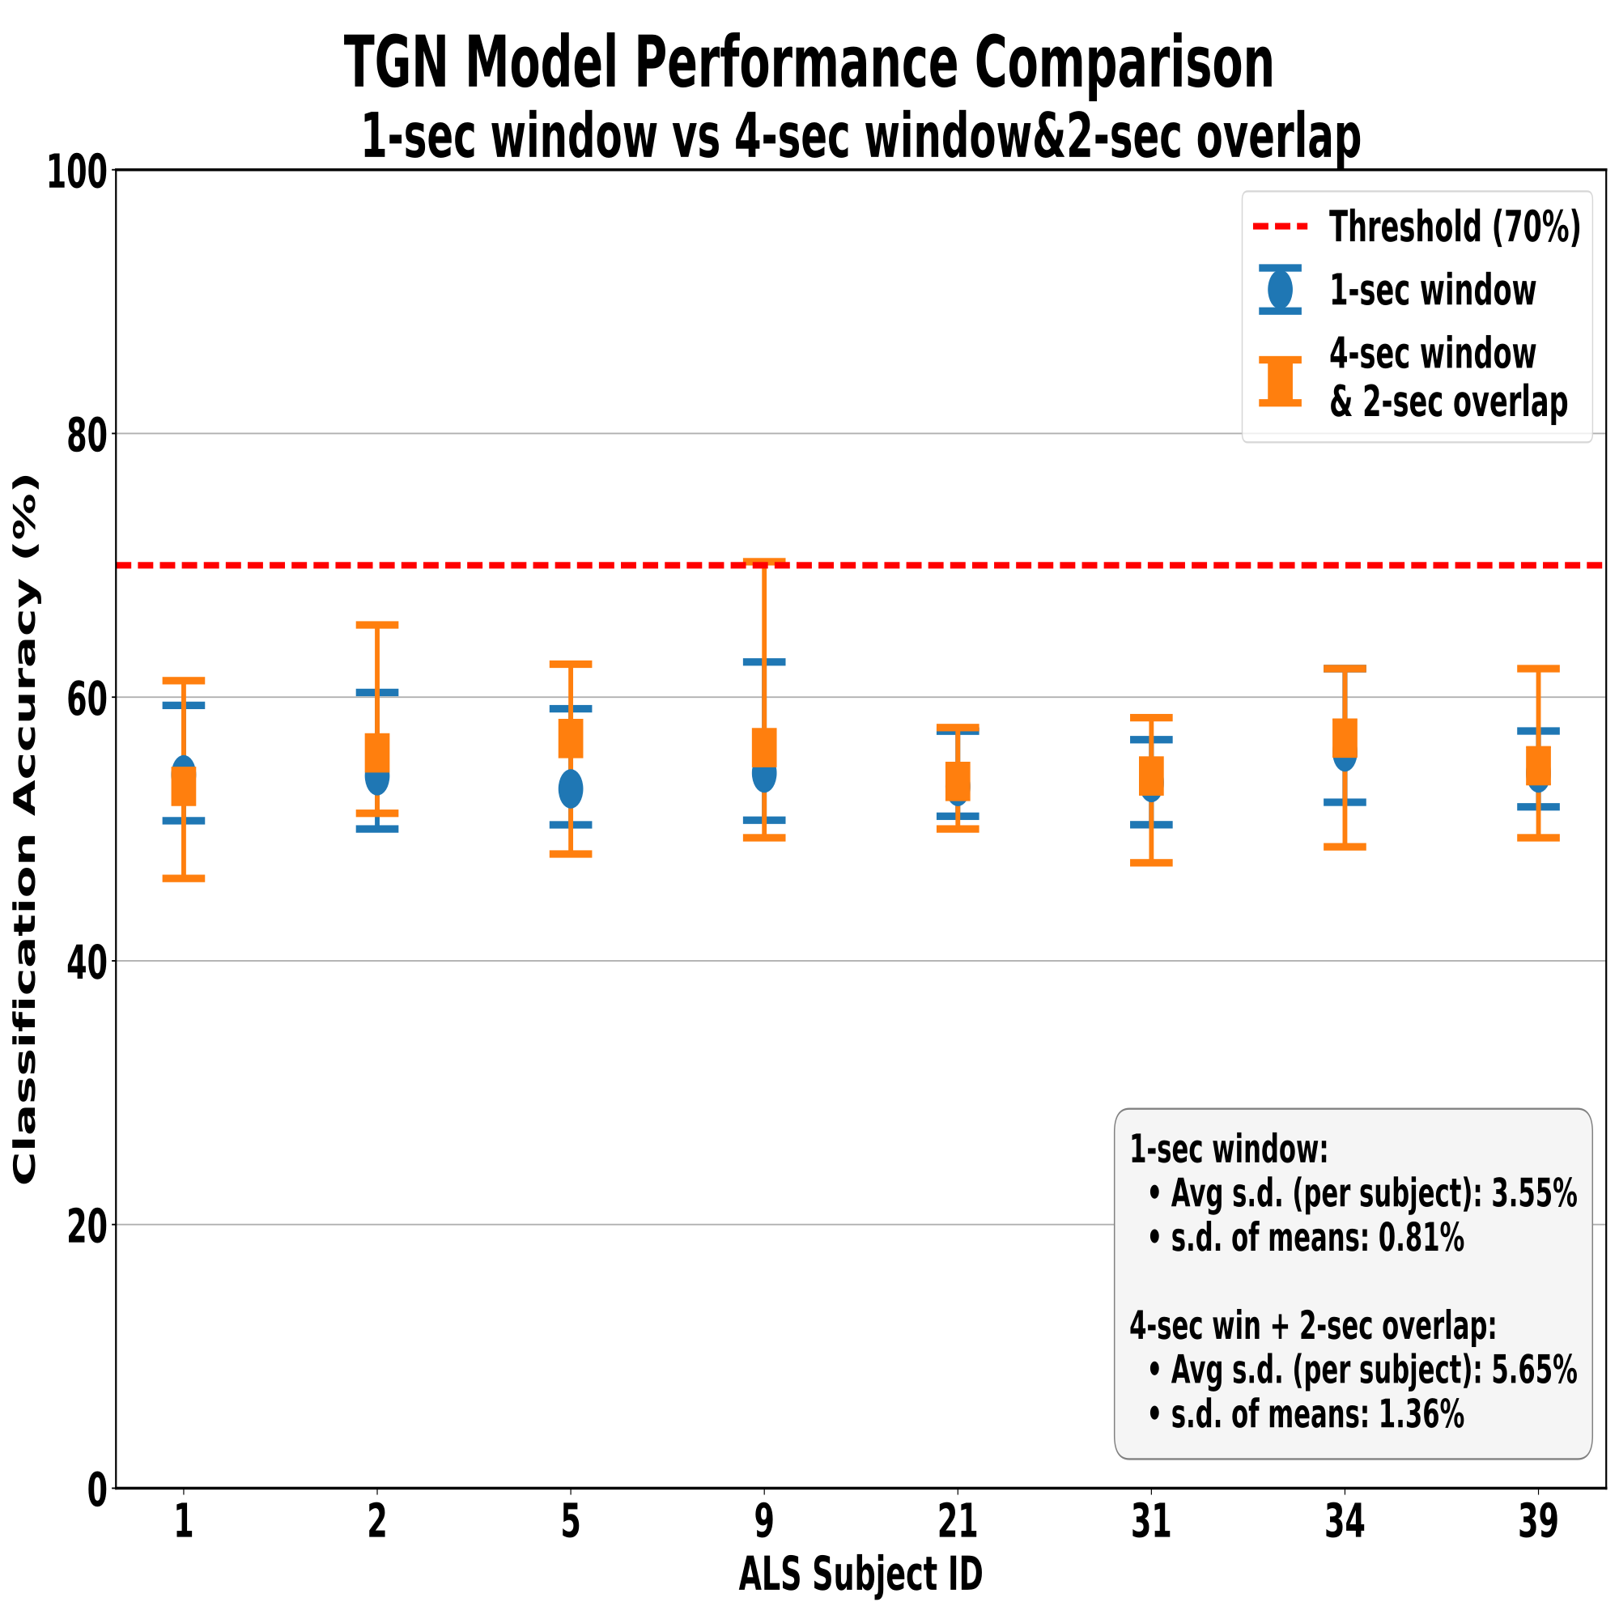
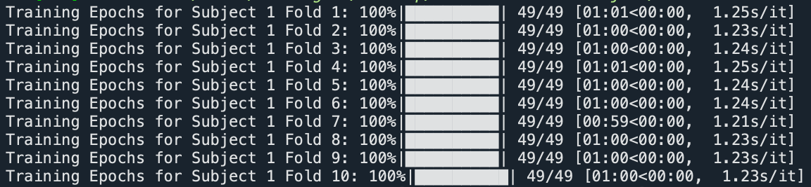
TGN Model - Improvement I: Window Overlapping
1-sec window vs 4-sec window&2-sec overlap:
-> faster
-> similar c.a. (NOT all subjects reach max 60% c.a.)
-> but higher s.d.

Slide 41
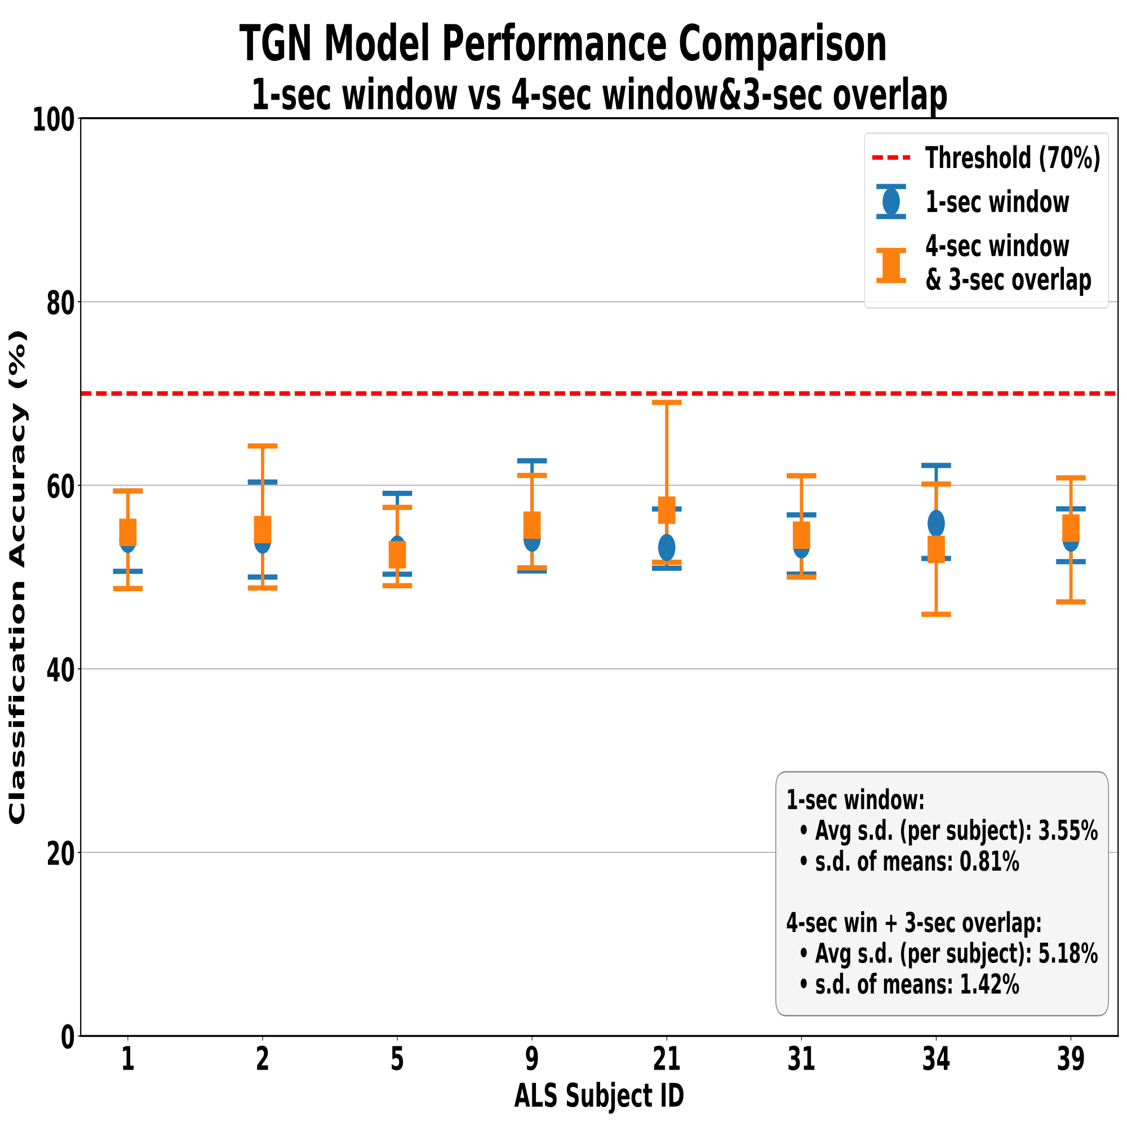
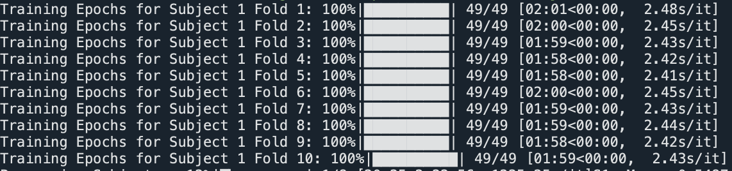
TGN Model - Improvement I: Window Overlapping
1-sec window vs 4-sec window&3-sec overlap:
-> similar speed
-> similar mean c.a.(NOT all subjects reach max 60% c.a.)
-> but higher s.d.

Slide 42
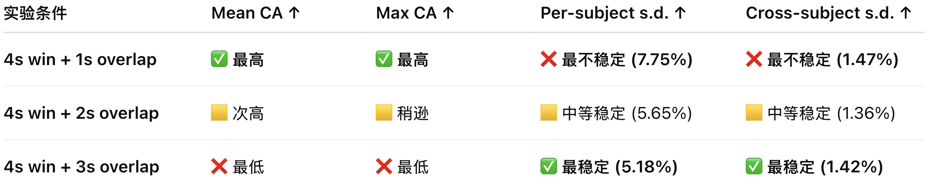
TGN Model - Improvement I: Window Overlapping

Slide 43

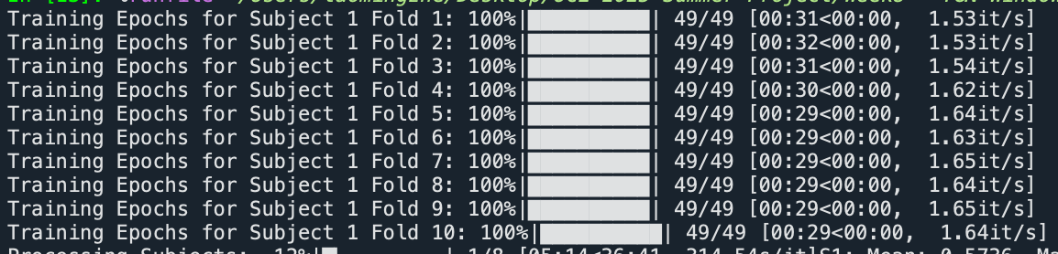
TGN Model - Improvement I: Window Overlapping
1-sec window vs 5-sec window&1-sec overlap:
-> faster
-> higher mean c.a. (all subjects reach 70% c.a. for max)
-> but higher s.d.

Slide 44
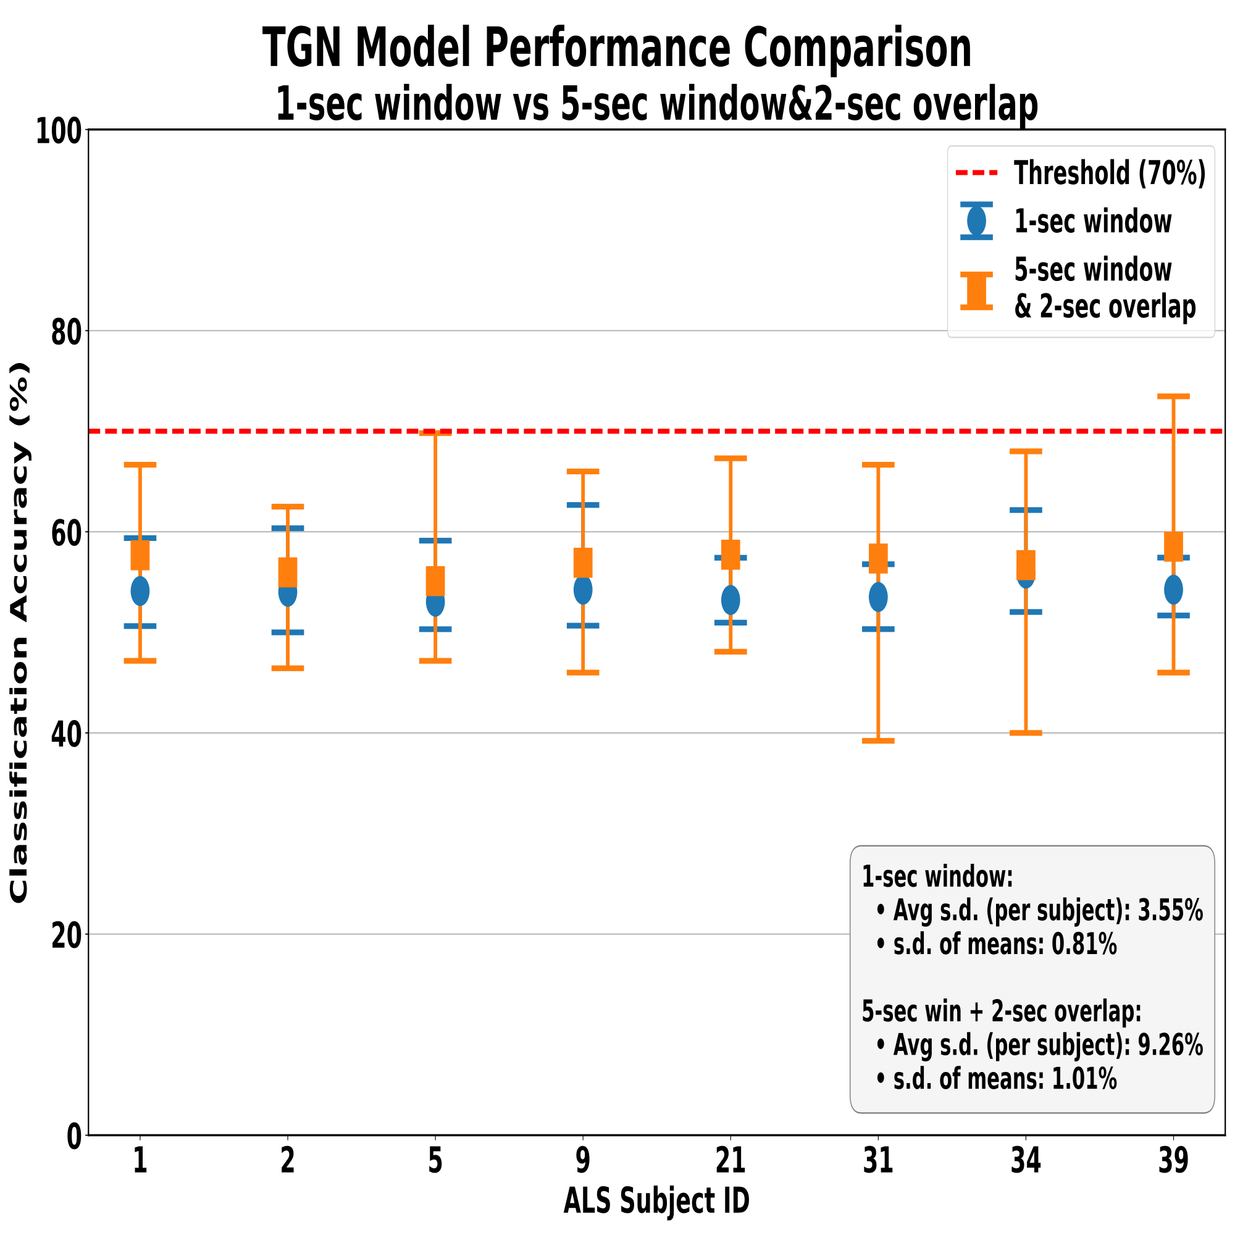
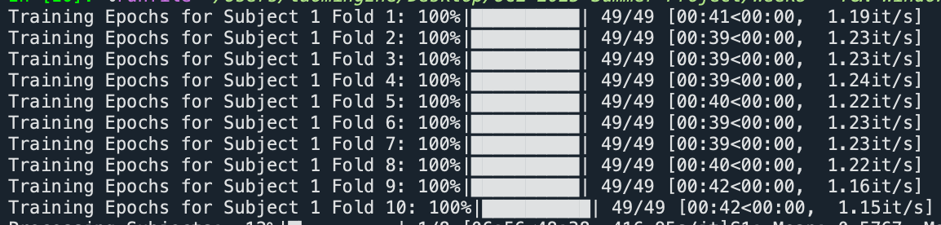
TGN Model - Improvement I: Window Overlapping
1-sec window vs 5-sec window&2-sec overlap:
-> faster
-> similar mean c.a.(all subjects reach max 60% c.a.)
-> but higher s.d.

Slide 45
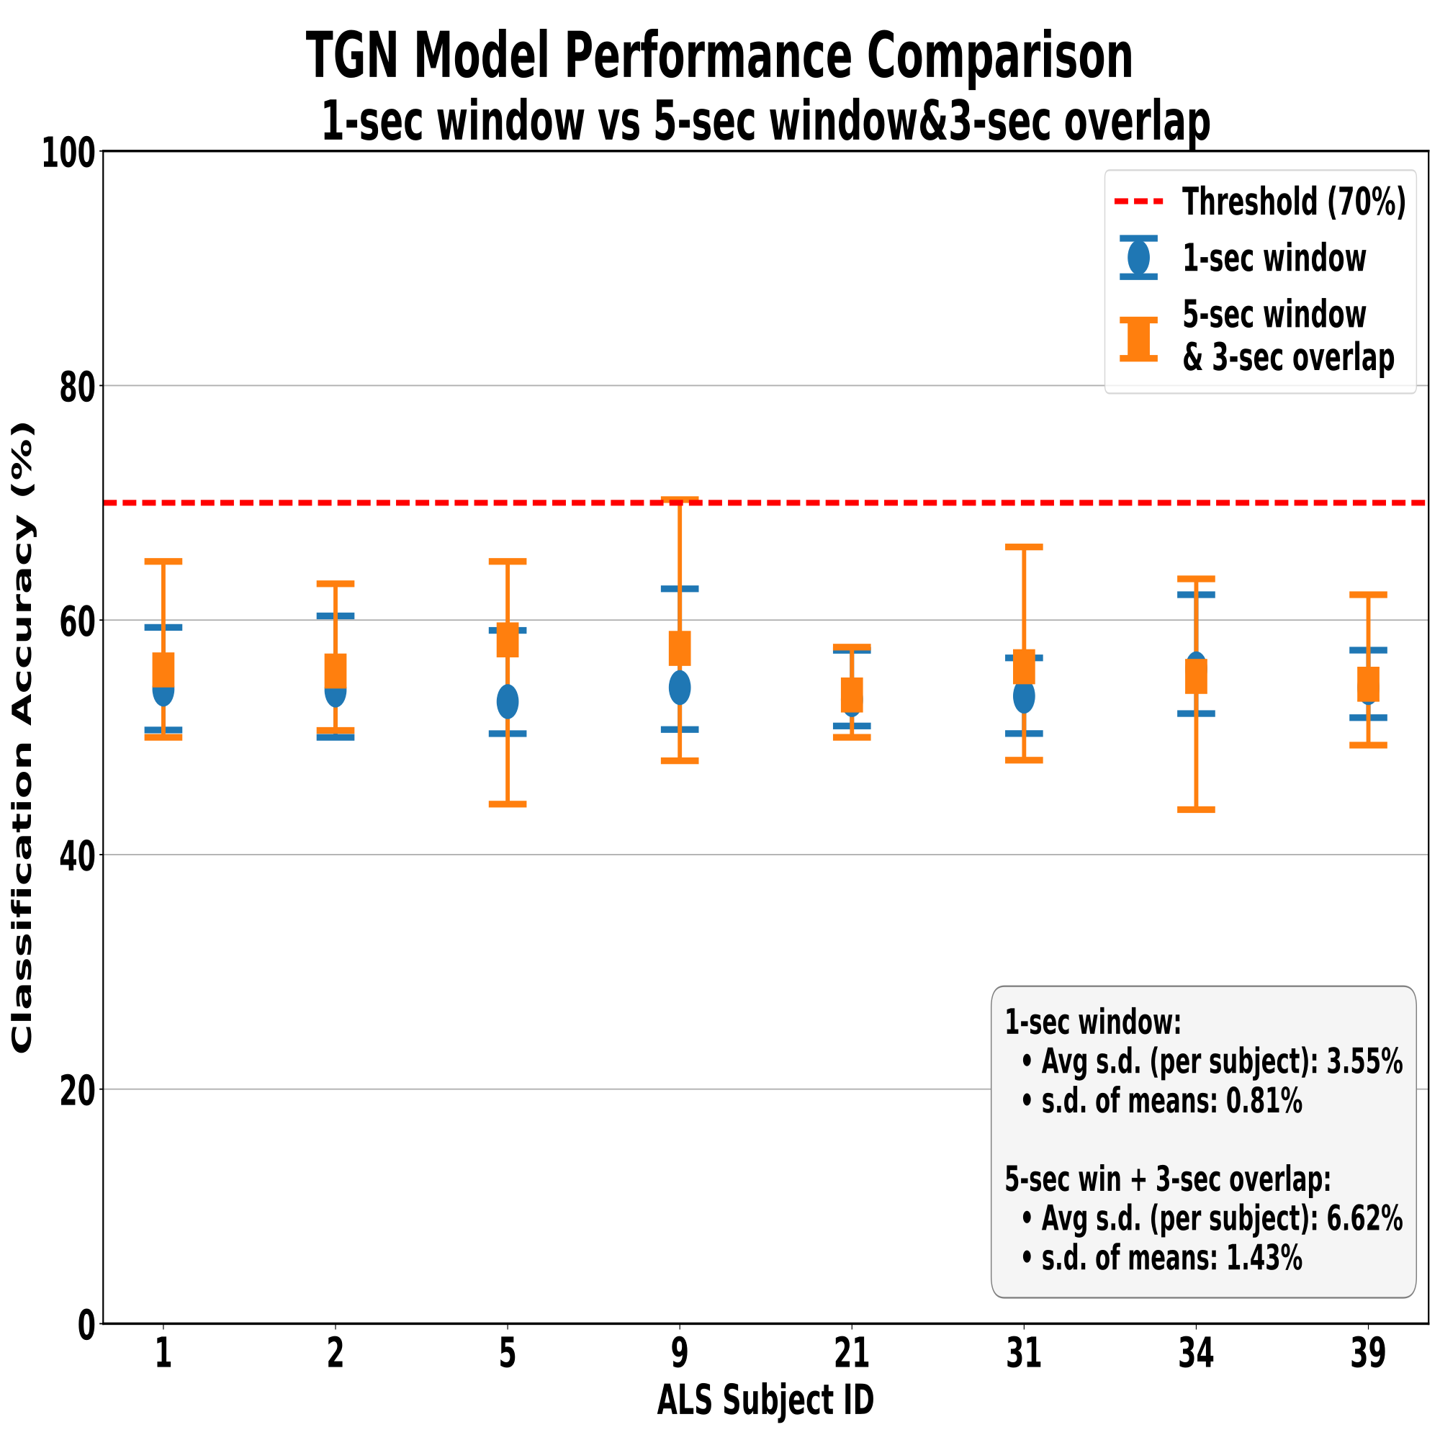
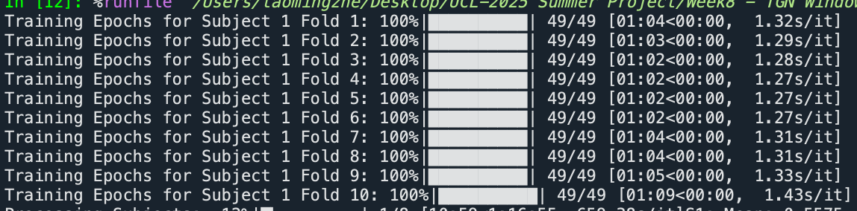
TGN Model - Improvement I: Window Overlapping
1-sec window vs 5-sec window&3-sec overlap:
-> faster
-> similar mean c.a.(NOT all subjects reach max 60% c.a.)
-> but higher s.d.

Slide 46

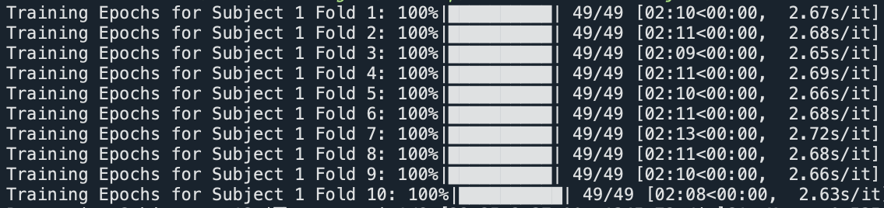
TGN Model - Improvement I: Window Overlapping
1-sec window vs 5-sec window&4-sec overlap:
-> similar speed
-> similar mean c.a. (NOT all subjects reach max 60% c.a.)
-> but higher s.d.

Slide 47
TGN Model - Improvement I: Window Overlapping
As overlap size gets smaller, mean&max c.a. increase, while per-&cross-sub variances also increase:
-> smaller overlap size reduces data redundancy, each successive window contains more new information;
-> but it also weakens cross-window consistent/continuity, so subject-sensitive, i.e. less generalization.

Slide 48


TGN Model - Improvement I: Window Overlapping
1-sec window vs 6-sec window&1-sec overlap:
-> faster
-> higher mean c.a. (NOT all subjects reach max 70% c.a.)
-> but higher s.d.

Slide 49


TGN Model - Improvement I: Window Overlapping
1-sec window vs 6-sec window&2-sec overlap:
-> faster
-> higher mean c.a. (NOT all subjects reach max 70% c.a.)
-> but higher s.d.

Slide 50


TGN Model - Improvement I: Window Overlapping
Overlap size ⬇️: mean&max c.a. ⬆️, per-&cross-sub s.d.⬆
Final decision: one window = one trial, no overlap!!!
-> compute one PLV matrix per trial
-> one TemporalData object = one temporal graph = one trial = one plvMatrix
= multiple events (src, dst, t, msg), where each event has
its own src, dst, timestamp, msg.

Slide 51


TGN Model - Improvement I: Window Overlapping
1-sec window vs 1-trial&no overlap:
-> faster?
-> higher mean c.a. (NOT all subjects reach max 70% c.a.)?
-> but higher s.d.?

Slide 52

TGN Model - Improvement I: Window Overlapping
Larger window size make the model outcomes better?
Overall window slicing principle:
(1) 必须先拼接再切窗以保持全局时间顺序;
(2) 任何窗口都不跨 trial, 不产生泄漏.
-> apply Mask boundaries in concatenation.
(3) set window size same for all trials of all subjects first.

Slide 53


TGN Model - Improvement I: Window Overlapping
How to determine the max window size???
$$119÷256=0.46 seconds$$

Slide 54


TGN Model - Improvement I: Window Overlapping

Slide 55

TGN Model - Improvement I: Window Overlapping
large window size & small overlap size:
-> window size = 4s, 5s
-> overlap size = 1s (20%, 10%, 5%...)

Slide 56



TGN Model - Improvement I: Window Overlapping
1-sec window vs 3-sec window&1-sec overlap: MAKE NO DIFFERENCE!
-> faster $√$
-> similar mean c.a. (NOT all subjects reach max 60% c.a.) $√$
-> but higher s.d. $×$
the purple one has highest max c.a., but that is due to the allowed cross-trial windows - artificial temporal continuity?
the orange one introduces artificial gaps between trials to ensure no window crosses trial boundaries, but lower c.a. due to artificial temporal reorder/delay?
Notes:
the ‘purple overlap’scenario led to an artificially inflated performance because it introduced temporal boundary violations. In other words, by allowing windows to cross trial boundaries, the model saw a temporal continuity that doesn’t actually exist in real data. This effectively created a form of temporal data leakage, leading to artificially optimistic performance. This condition doesn’t reflect the true model capability but rather a methodological artifact.
In the new approach (the orange dataset), we introduced artificial gaps between trials to ensure that no window crosses trial boundaries. While this method eliminates cross-trial leakage and makes the evaluation more robust, it also introduces some artificial temporal discontinuities. This may slightly reduce accuracy or create a trade-off in the results, but it ensures that our evaluation remains methodologically sound.

Slide 57


TGN Model - Improvement I: Window Overlapping
1-sec window vs 4-sec window&1-sec overlap:
-> faster
-> similar mean c.a. (all subjects reach max 60% c.a.)
-> but higher s.d.

Slide 58


TGN Model - Improvement I: Window Overlapping
1-sec window vs 4-sec window&10%overlap:
-> faster
-> similar mean c.a. (all subjects reach max 60% c.a.)
-> but higher s.d.

Slide 59


TGN Model - Improvement I: Window Overlapping
1-sec window vs 4-sec window&5%overlap:
-> faster
-> similar mean c.a. (NOT all subjects reach max 60% c.a.)
-> but higher s.d.

Slide 60


TGN Model - Improvement I: Window Overlapping
1-sec window vs 5-sec window&1-sec overlap:
-> faster
-> similar mean c.a. (all subjects reach max 60% c.a.)
-> but higher s.d.

Slide 61


TGN Model - Improvement I: Window Overlapping
1-sec window vs 5-sec window&10% overlap:
-> faster
-> similar mean c.a. (all subjects reach max 60% c.a.)
-> but higher s.d.

Slide 62


TGN Model - Improvement I: Window Overlapping
1-sec window vs 5-sec window&5% overlap:
-> faster
-> similar mean c.a. (all subjects reach max 60% c.a.)
-> but higher s.d.

Slide 63

TGN Model - Improvement I: Window Overlapping
Overlap size ️🔽️: mean&max c.a. ⬆️; per-&cross-sub s.d.⬆️
$$√$$

Slide 64


TGN Model - Improvement I: Window Overlapping
1-sec window vs trial-length window:
-> much slower
-> similar mean c.a. (3 subjects have max c.a.< 70%)
-> higher s.d.

Slide 65

TGN Model - Improvement II: Cross-Subject Batching
Cross-subject batching mostly aims to improve generalization across subjects, so the largest expected gain is a reduction in cross-subject std.
Outer loop becomes over window index first, not trial;
Collect TemporalData objects by window index across subjects & trials.

Slide 66

TGN Model - Improvement II: Cross-Subject Batching
1-sec window vs. cross-subject batching:
-> much slower
-> similar mean c.a. (4 subjects have max c.a.< 70%)
-> higher s.d.

Slide 67

TGN Model - Improvement II: Cross-Subject Batching
Trial-wise temporal dynamics are important for TGN, and pushing cross-subject homogeneity harms it without any adaptation mechanism.

Slide 68

TGN Model - Improvement III: Log(PLV)
1-sec window vs. np.log(plv + 1e-6):
-> much slower
-> similar mean c.a. (7 subjects have max c.a.< 70%)
-> higher s.d.

Slide 69


TGN Model - Improvement IV: PLV Threshold>0
1-sec window vs. plv threshold>0:
-> much slower
-> similar mean c.a. (6 subjects have max c.a.< 70%)
-> higher s.d.

Slide 70
TGN Model - Improvement Summary
apply ‘cross-subject batching’
apply ‘log(plv)’
apply ‘plv threshold filtering’

Slide 71
TGN Model - Improvement V: TGN Replacement
GATv2Conv? / TGN+GAT hybrids?
RGATConv?
GMMConv?
SplineConv?
NNConv?
CGConv?
HypergraphConv?
PNAConv?
GENConv?
PDNConv?
GeneralConv?
HEATConv?
all have ‘edge_attr’ in forward func
Notes:
DynamicEdgeConv???? repeat same layers

Slide 72

TGN Model - Improvement V: TGN Replacement
GATv2Conv?

Slide 73

TGN Model - Improvement V: TGN Replacement
RGATConv?

Slide 74

TGN Model - Improvement V: TGN Replacement
GMMConv?

Slide 75

TGN Model - Improvement VI: TGN Layers $×$3
1-sec window vs. 3* TransformerConv layer:
-> much slower
-> similar mean c.a. (7 subjects have max c.a.< 70%)
-> higher s.d.

Slide 76

TGN Model - Improvement VII: Optuna
Optuna runs a loop calling objective(trial) many times, with different trial parameters
Runs Optuna (fast single-fold tuning + pruning), then runs full K-fold with best params
Notes:
允许剪枝 (pruning)：当中间结果不好时尽早停止当前 trial

Slide 77

TGN Model - Improvement VII: Optuna
1-sec window vs. :
-> much slower
-> similar mean c.a. (7 subjects have max c.a.< 70%)
-> higher s.d.

